Slide 1
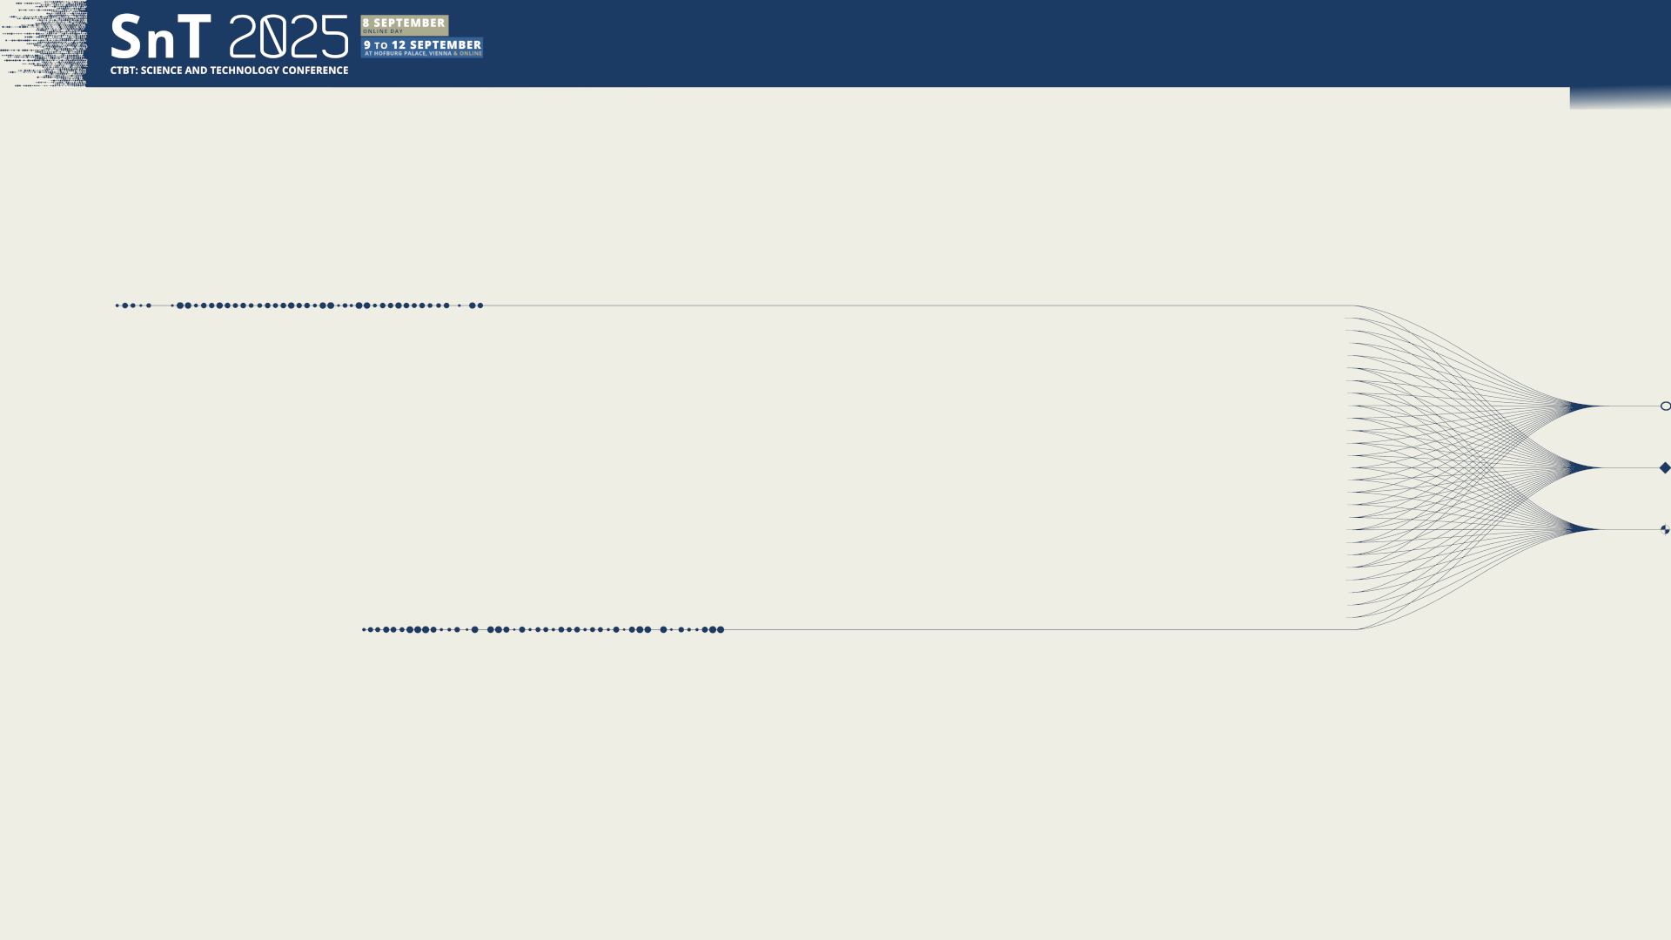


T1.3 - 299
A Portable Experimental Buoy for Coastal Acoustic Monitoring as a Potential Complement to the IMS Hydroacoustic Network: Applications on the Argentinian Continental Shelf
Prario, I. Bos, P. Marques Rojo, R. Cinquini,M. Blanc, S.
Argentinian Navy Research Office & UNIDEF (CONICET)
Presentation Date: 11 September 2025

Slide 2
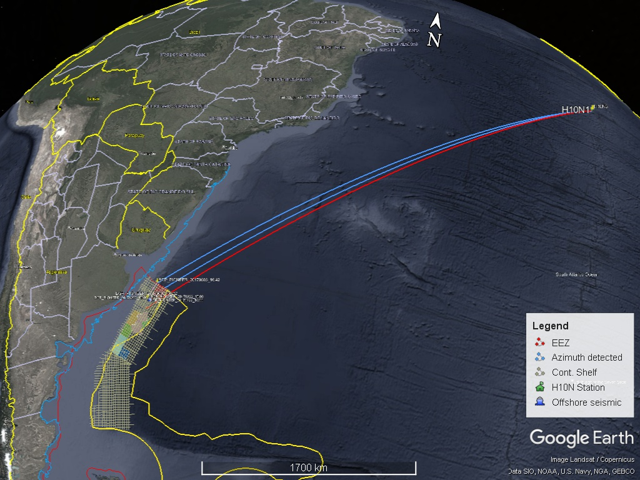
T1.3 - 299
A Portable Experimental Buoy for Coastal Acoustic Monitoring
Prario, I; Bos, P; Marques Rojo, R; Cinquini, M; Blanc, S.
Background
Airgun array used in seismic surveys generate sound pulses (5–60 Hz) that can propagate over ocean-basin scales.
Under favourable conditions, signals reach CTBT IMS hydroacoustic (HA) stations with high SNR.
On the Argentinian Continental Shelf, airgun signals detected at H10N can be used to validate long-range propagation models ⁽¹⁾.
Limitations: highly directional sources and shallow-water propagation reduce detectability.
Challenge: synchronize ground-truth airgun shots with H10N recordings.
⁽¹⁾ SnT2021 P1.3-494 An inverse problem approach for acoustic Transmission Loss estimation from the analysis of signals generated by seismic air-gun arrays. SnT2023 O1.3-536 Analysis of bathymetric effects on long-range acoustic propagation using 2D and 3D Transmission Loss models in signals generated by airgun arrays.

Slide 3
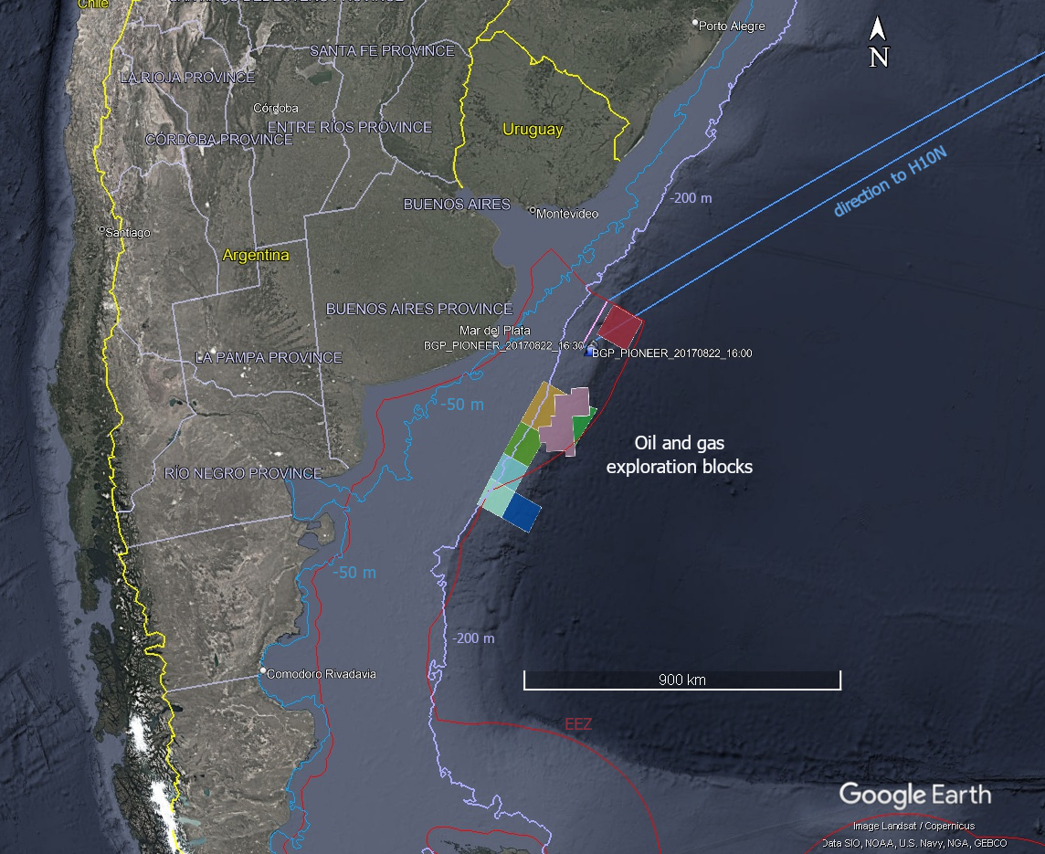
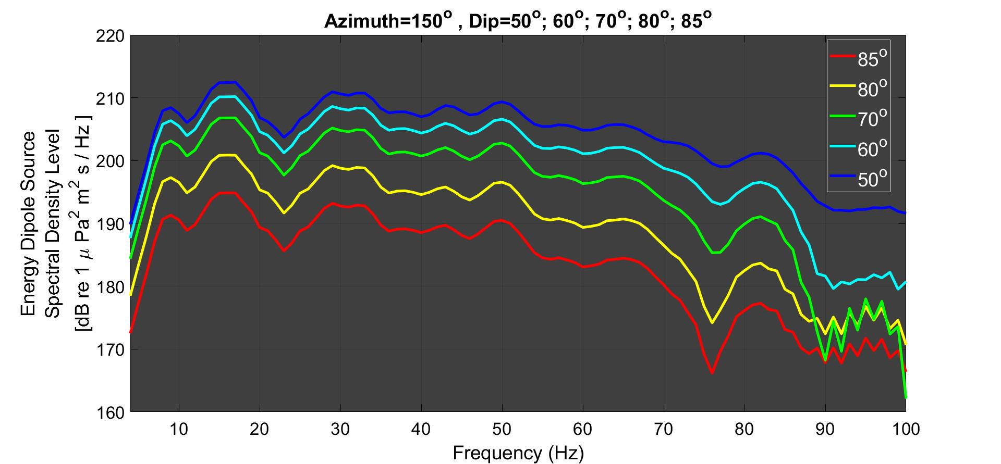
T1.3 - 299
A Portable Experimental Buoy for Coastal Acoustic Monitoring
Prario, I; Bos, P; Marques Rojo, R; Cinquini, M; Blanc, S.
Motivation
Offshore Argentina: seismic surveys are conducted in oil & gas exploration blocks.
Large dataset of high-amplitude impulsive signals → basin-scale range propagation analysis.
Airgun array source levels simulated with an open-source airgun modelling software⁽²⁾; source energy concentrated in 5–70 Hz band (HA10 direction); SL~ 210-190 dB re 1uPa²m²s.
Need for local measurement sites on the Continental Shelf (airgun shots signals & other underwater noise sources).
(2) Sertlek, H. O., and Ainslie, M. A. (2015). “AGORA: Airgun Source Signature Model: Its application for the Dutch Seismic Survey,” in Proceedings of Underwater Acoustics Conference and Exhibition, Crete, Greece, pp. 439–446,

Slide 4
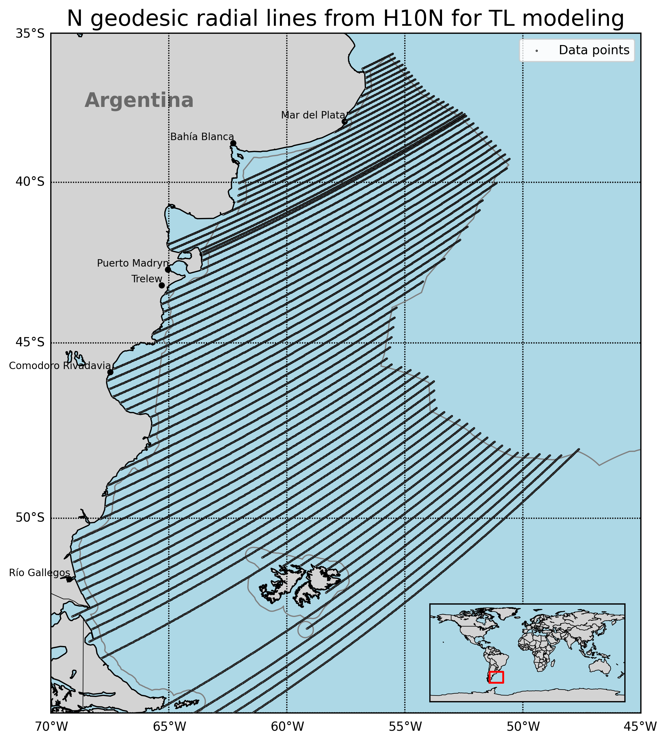
T1.3 - 299
A Portable Experimental Buoy for Coastal Acoustic Monitoring
Prario, I; Bos, P; Marques Rojo, R; Cinquini, M; Blanc, S.
Acoustic coverage in Argentinian Continental Shelf
Acoustic coverage areas of the HA10 station: preliminary analysis using 2D Parabolic Equation (PE) model RAM (Range-dependent Acoustic Model, Julia implementation).
Acoustic scenario:
Oceanographic databases: T, S profiles from Copernicus; bathymetry from GEBCO.
Frequencies band analyzed: 2–100 Hz.
Transmission Loss (TL) computed along Nx2D radial transects from H10N.
Source depth = 8 m (typical for airgun array).
Coverage criterion: TL < 200 dB; NL ~ 80 dB re 1uPa² .
Goal: identify candidate shallow-water sites (<200 m depth) for improved local monitoring.

Slide 5
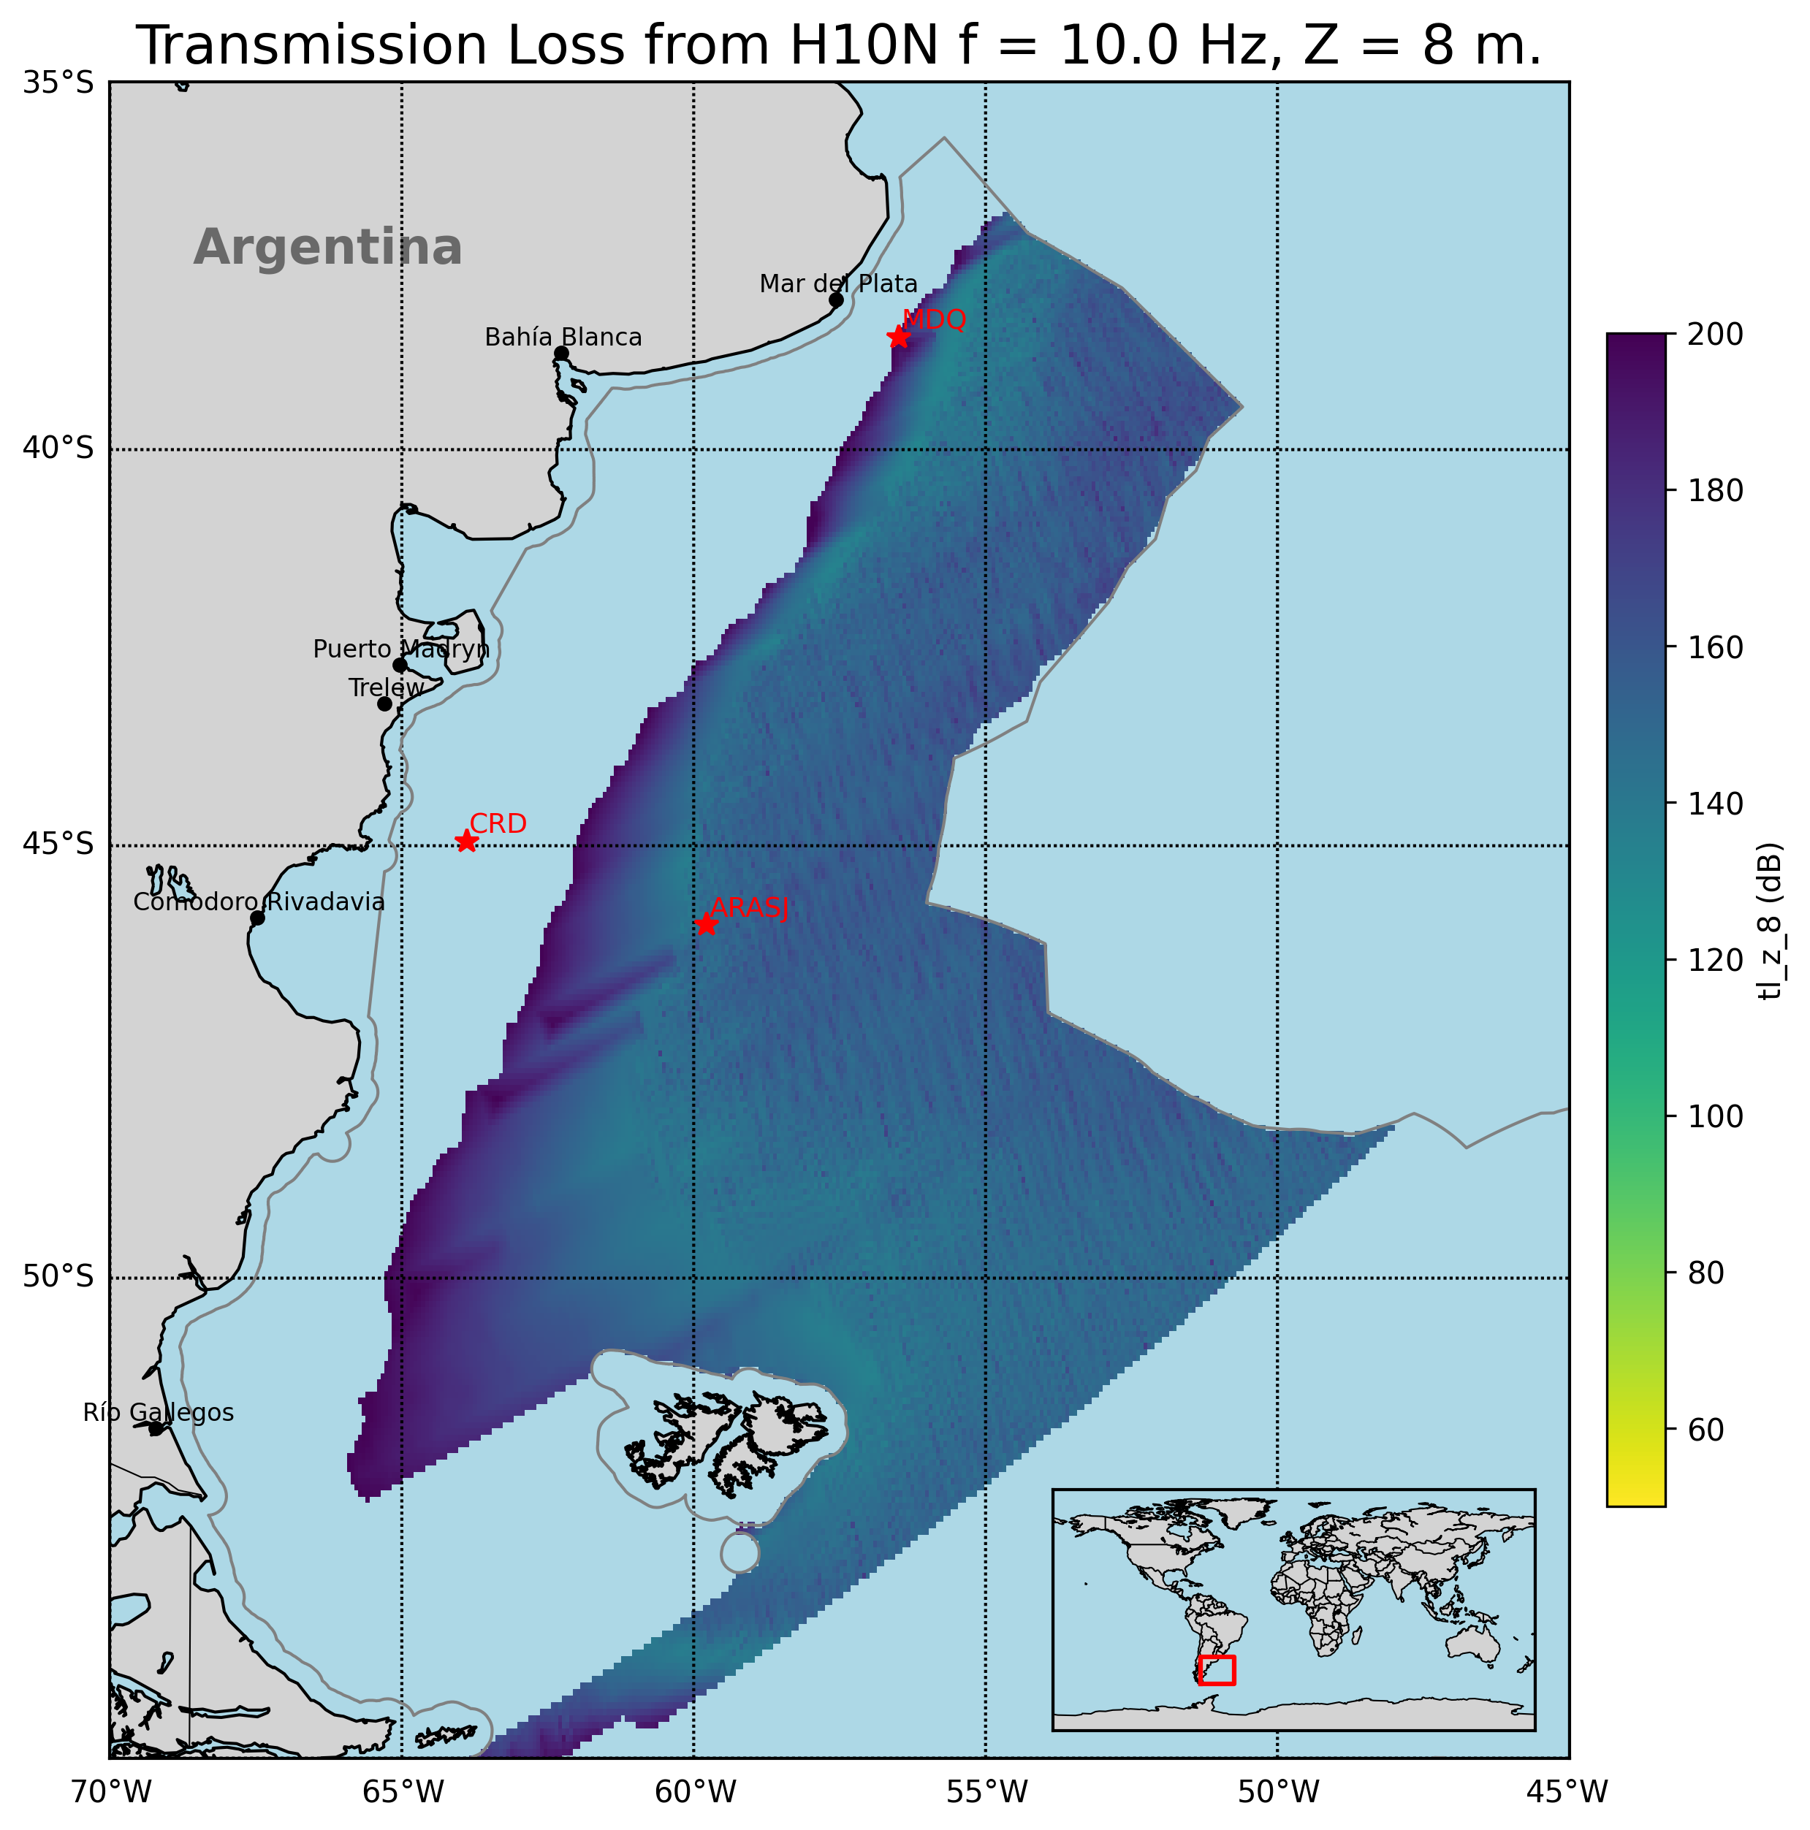
T1.3 - 299
A Portable Experimental Buoy for Coastal Acoustic Monitoring
Prario, I; Bos, P; Marques Rojo, R; Cinquini, M; Blanc, S.
Offshore Argentina coverage of Ascention station H10N
Strong frequency dependence:
Low frequencies (<10 Hz): coastal shadow zones, TL > 200 dB.
Higher frequencies (10–80 Hz): partial coverage, but limited in shallow waters.
Argentine continental slope acts as an acoustic filter.
Coastal coverage gaps: long-range IMS hydroacoustic stations miss nearshore regions.
Local minima of TL in the continental slope (ARA San Juan wreckage, signal of 2017 implosion event was detected in two IMS-HA stations³)
Offshore candidate sites identified: 1-MDQ, 2-CRD
³ Prario, I., Cinquini, M., Marques Rojo, R. et al. Characterization of the Acoustic Event Associated with the Loss of the ARA San Juan Submarine Based on Long-Range Measurements by CTBTO’s Hydrophone Stations. Pure Appl. Geophys. 180, 1317–1342 (2023). https://doi.org/10.1007/s00024-022-03090-0.

Slide 6
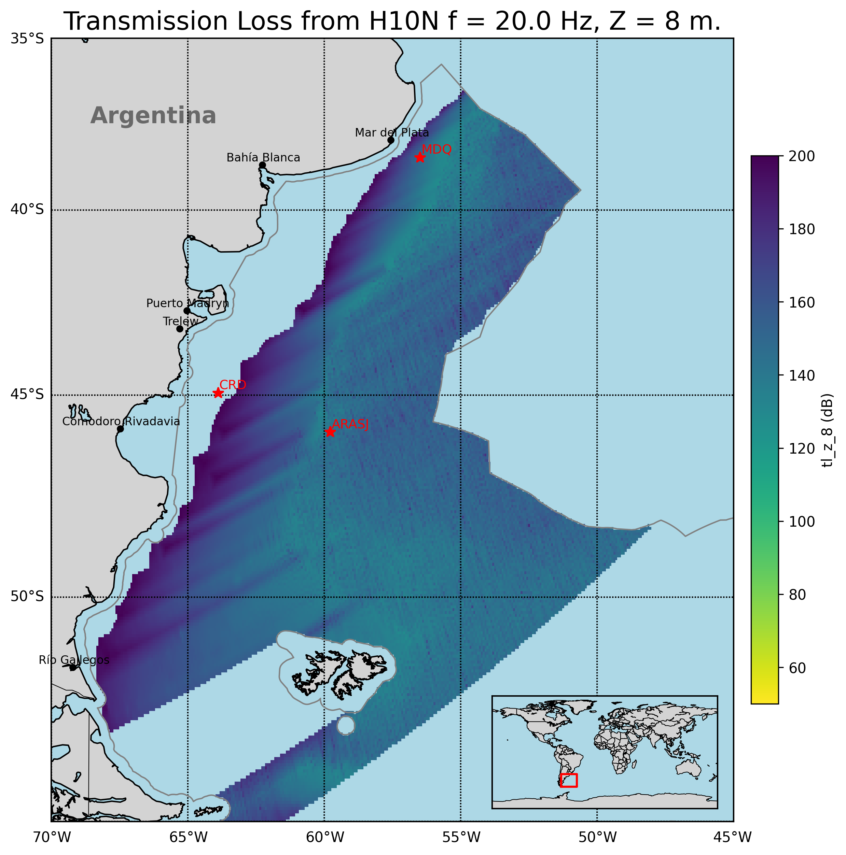
T1.3 - 299
A Portable Experimental Buoy for Coastal Acoustic Monitoring
Prario, I; Bos, P; Marques Rojo, R; Cinquini, M; Blanc, S.
Offshore Argentina coverage of Ascention station H10N
Strong frequency dependence:
Low frequencies (<10 Hz): coastal shadow zones, TL > 200 dB.
Higher frequencies (10–80 Hz): partial coverage, but limited in shallow waters.
Argentine continental slope acts as an acoustic filter.
Coastal coverage gaps: long-range IMS hydroacoustic stations miss nearshore regions.
Local minima of TL in the continental slope (ARA San Juan wreckage, signal of 2017 implosion event was detected in two IMS-HA stations³)
Offshore candidate sites identified: 1-MDQ, 2-CRD
³ Prario, I., Cinquini, M., Marques Rojo, R. et al. Characterization of the Acoustic Event Associated with the Loss of the ARA San Juan Submarine Based on Long-Range Measurements by CTBTO’s Hydrophone Stations. Pure Appl. Geophys. 180, 1317–1342 (2023). https://doi.org/10.1007/s00024-022-03090-0.

Slide 7
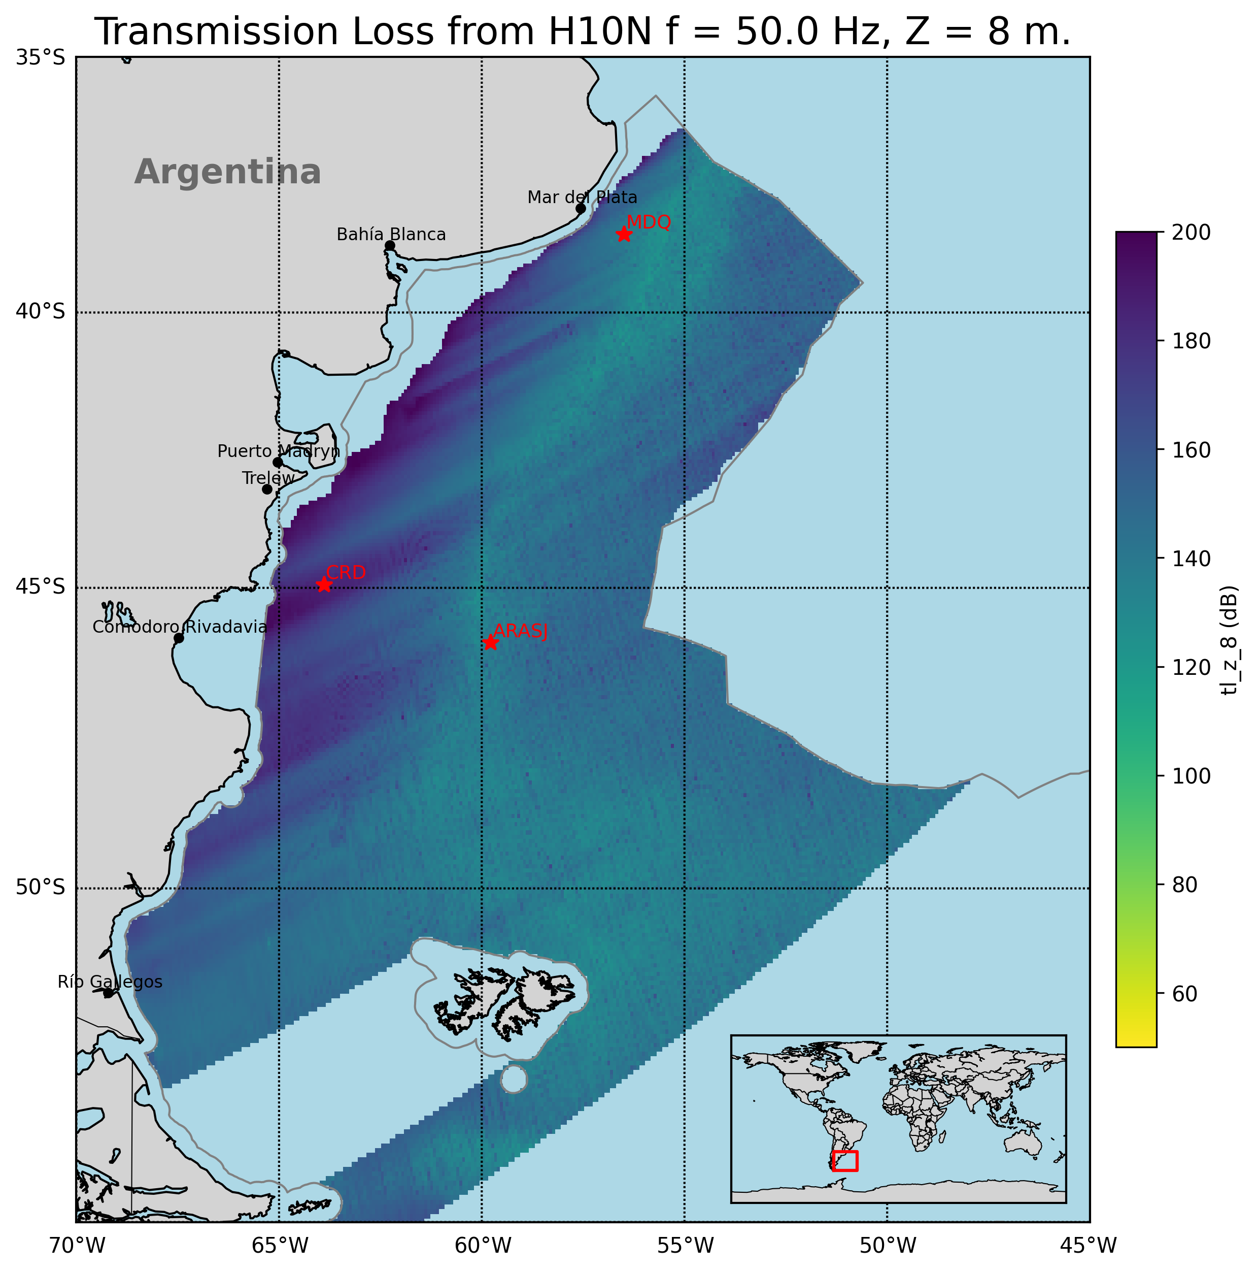
T1.3 - 299
A Portable Experimental Buoy for Coastal Acoustic Monitoring
Prario, I; Bos, P; Marques Rojo, R; Cinquini, M; Blanc, S.
Offshore Argentina coverage of Ascention station H10N
Strong frequency dependence:
Low frequencies (<10 Hz): coastal shadow zones, TL > 200 dB.
Higher frequencies (10–80 Hz): partial coverage, but limited in shallow waters.
Argentine continental slope acts as an acoustic filter.
Coastal coverage gaps: long-range IMS hydroacoustic stations miss nearshore regions.
Local minima of TL in the continental slope (ARA San Juan wreckage, signal of 2017 implosion event was detected in two IMS-HA stations³)
Offshore candidate sites identified: 1-MDQ, 2-CRD
³ Prario, I., Cinquini, M., Marques Rojo, R. et al. Characterization of the Acoustic Event Associated with the Loss of the ARA San Juan Submarine Based on Long-Range Measurements by CTBTO’s Hydrophone Stations. Pure Appl. Geophys. 180, 1317–1342 (2023). https://doi.org/10.1007/s00024-022-03090-0.

Slide 8
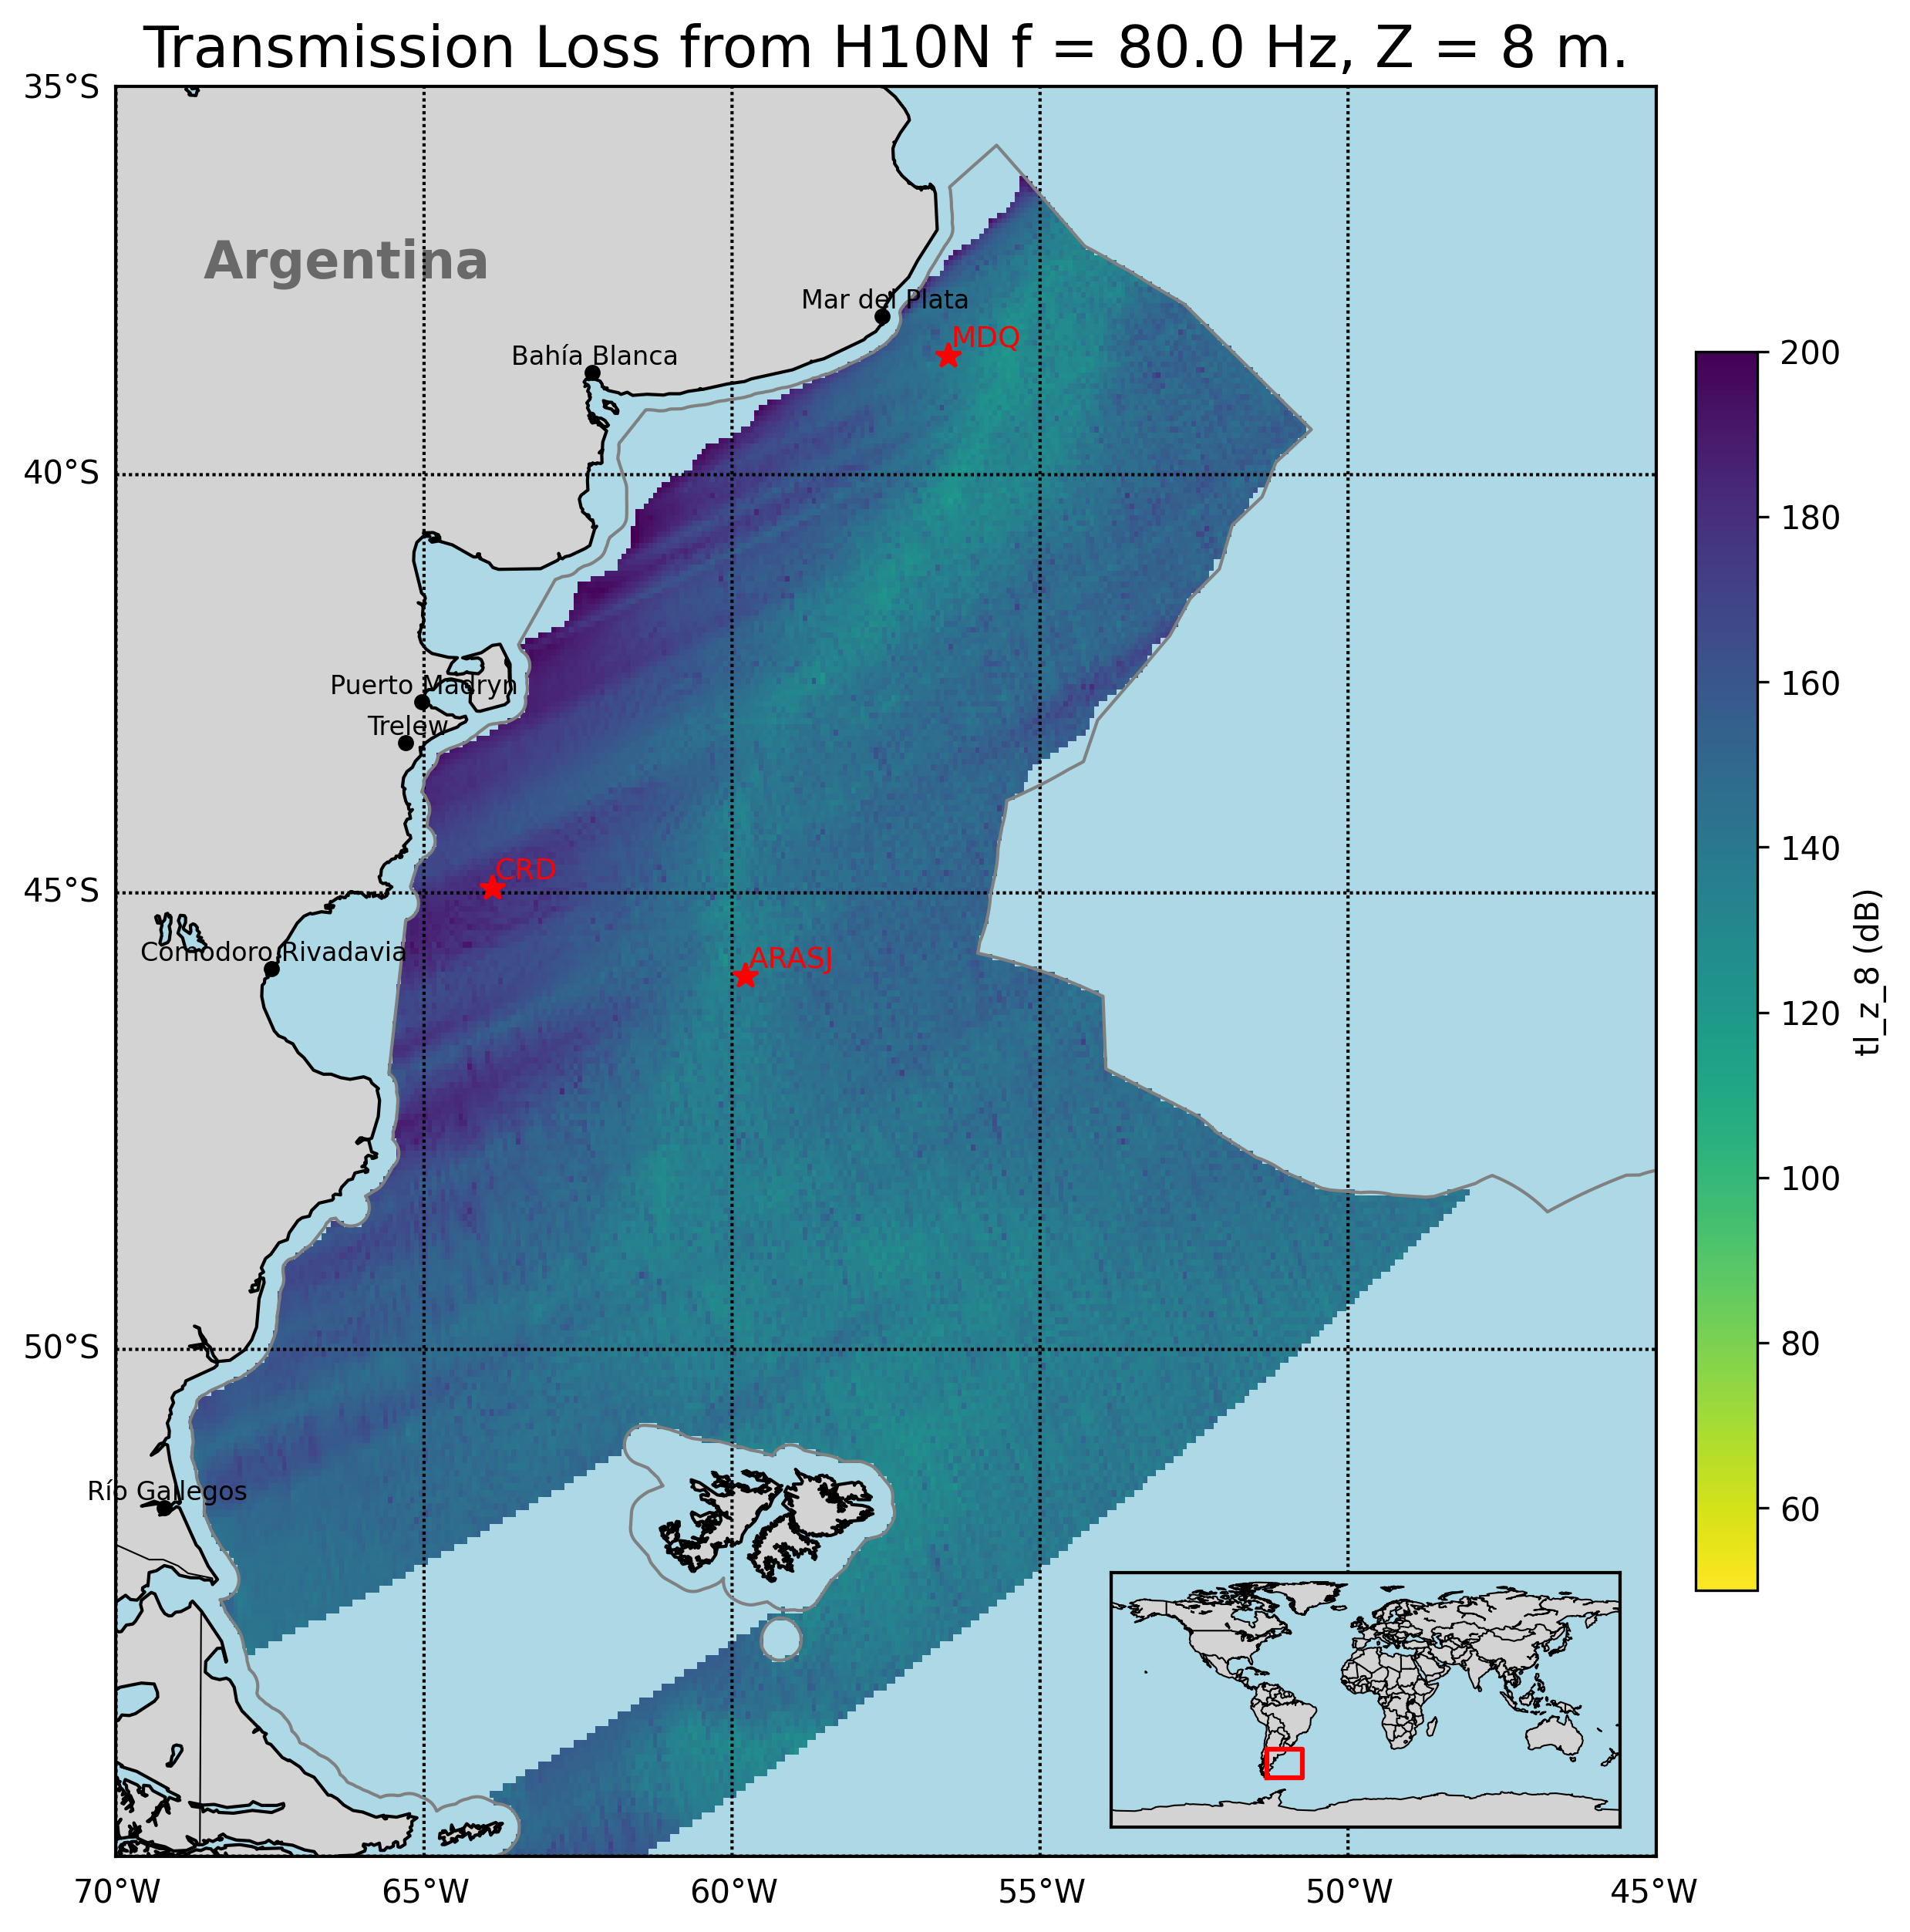
T1.3 - 299
A Portable Experimental Buoy for Coastal Acoustic Monitoring
Prario, I; Bos, P; Marques Rojo, R; Cinquini, M; Blanc, S.
Offshore Argentina coverage of Ascention station H10N
Strong frequency dependence:
Low frequencies (<10 Hz): coastal shadow zones, TL > 200 dB.
Higher frequencies (10–80 Hz): partial coverage, but limited in shallow waters.
Argentine continental slope acts as an acoustic filter.
Coastal coverage gaps: long-range IMS hydroacoustic stations miss nearshore regions.
Local minima of TL in the continental slope (ARA San Juan wreckage, signal of 2017 implosion event was detected in two IMS-HA stations³)
Offshore candidate sites identified: 1-MDQ, 2-CRD
³ Prario, I., Cinquini, M., Marques Rojo, R. et al. Characterization of the Acoustic Event Associated with the Loss of the ARA San Juan Submarine Based on Long-Range Measurements by CTBTO’s Hydrophone Stations. Pure Appl. Geophys. 180, 1317–1342 (2023). https://doi.org/10.1007/s00024-022-03090-0.

Slide 9
T1.3 - 299
A Portable Experimental Buoy for Coastal Acoustic Monitoring
Prario, I; Bos, P; Marques Rojo, R; Cinquini, M; Blanc, S.
Offshore Argentina coverage of Ascention station H10N
Strong frequency dependence:
Low frequencies (<10 Hz): coastal shadow zones, TL > 200 dB.
Higher frequencies (10–80 Hz): partial coverage, but limited in shallow waters.
Argentine continental slope acts as an acoustic filter.
Coastal coverage gaps: long-range IMS hydroacoustic stations miss nearshore regions.
Local minima of TL in the continental slope (ARA San Juan wreckage, signal of 2017 implosion event was detected in two IMS-HA stations³)
Offshore candidate sites identified: 1-MDQ, 2-CRD
³ Prario, I., Cinquini, M., Marques Rojo, R. et al. Characterization of the Acoustic Event Associated with the Loss of the ARA San Juan Submarine Based on Long-Range Measurements by CTBTO’s Hydrophone Stations. Pure Appl. Geophys. 180, 1317–1342 (2023). https://doi.org/10.1007/s00024-022-03090-0.

Slide 10
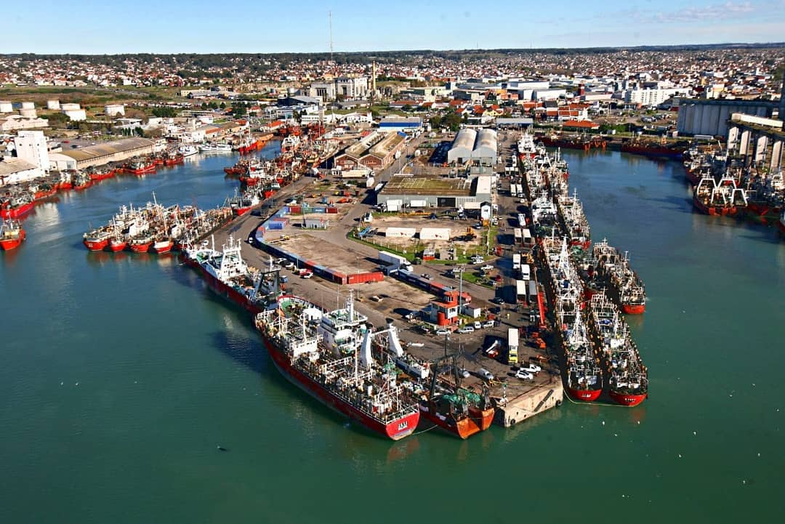
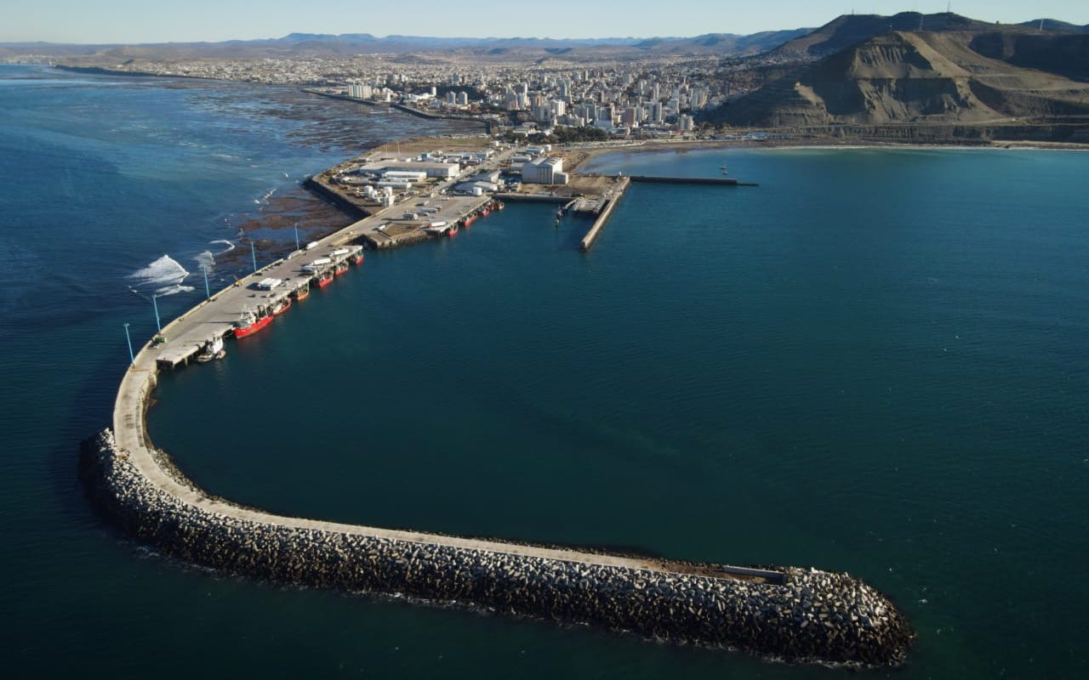
T1.3 - 299
A Portable Experimental Buoy for Coastal Acoustic Monitoring
Prario, I; Bos, P; Marques Rojo, R; Cinquini, M; Blanc, S.
Offshore Argentina coverage of Ascention station H10N
Strong frequency dependence:
Low frequencies (<10 Hz): coastal shadow zones, TL > 200 dB.
Higher frequencies (10–80 Hz): partial coverage, but limited in shallow waters.
Argentine continental slope acts as an acoustic filter.
Coastal coverage gaps: long-range IMS hydroacoustic stations miss nearshore regions.
Local minima of TL in the continental slope (ARA San Juan wreckage, signal of 2017 implosion event was detected in two IMS-HA stations³)
Offshore candidate sites identified: 1-MDQ, 2-CRD
³ Prario, I., Cinquini, M., Marques Rojo, R. et al. Characterization of the Acoustic Event Associated with the Loss of the ARA San Juan Submarine Based on Long-Range Measurements by CTBTO’s Hydrophone Stations. Pure Appl. Geophys. 180, 1317–1342 (2023). https://doi.org/10.1007/s00024-022-03090-0.

Slide 11
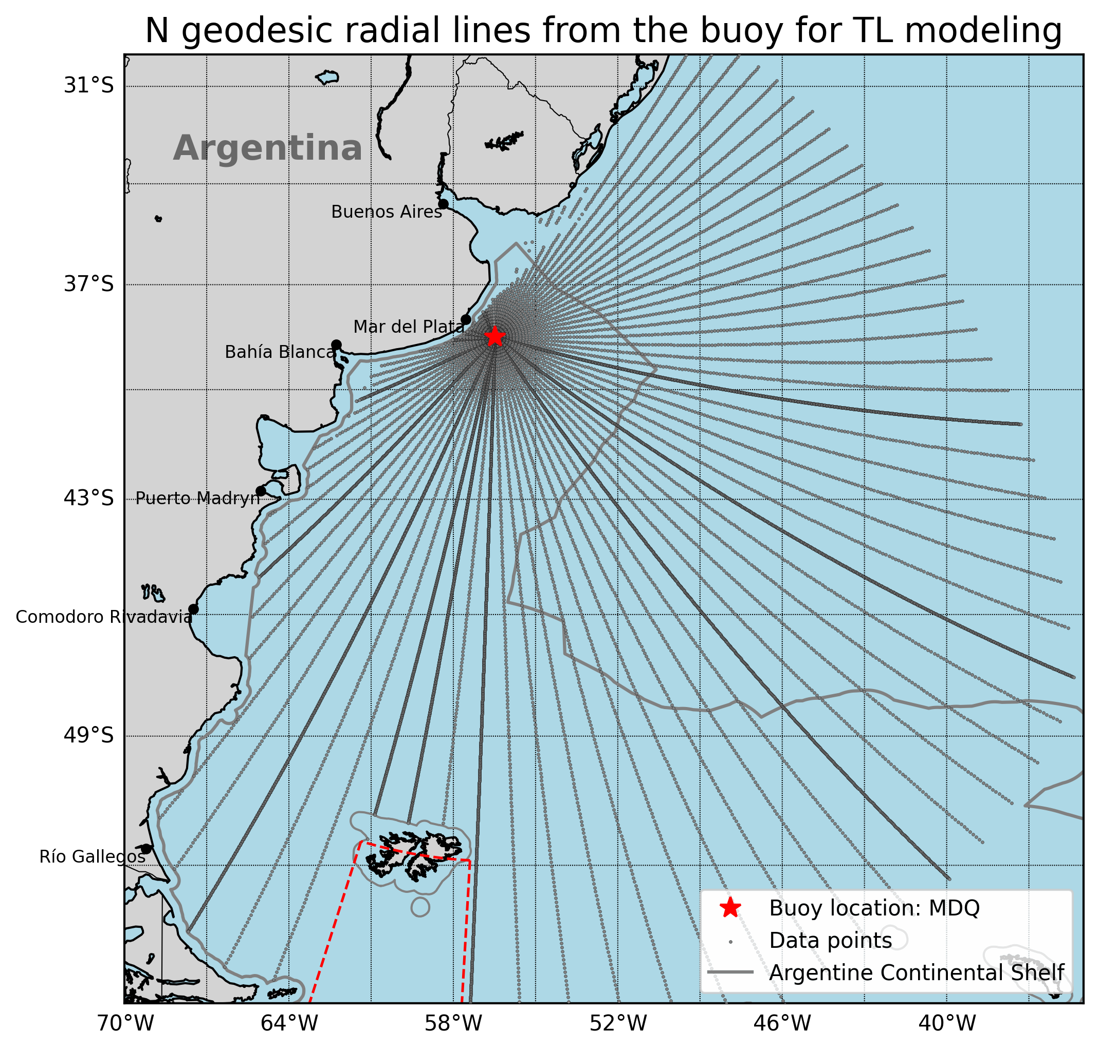
T1.3 - 299
A Portable Experimental Buoy for Coastal Acoustic Monitoring
Prario, I; Bos, P; Marques Rojo, R; Cinquini, M; Blanc, S.
Coverage of candidate 1 station (offshore Mar del Plata - MDQ)
Acoustic scenario:
Frequency range: 2–100 Hz (results shown at 10, 20, 50, 80 Hz).
Source depth = 8 m (typical airgun tow depth).
Receiver depth (hydrophone) = 40 m.
T, S profiles from Copernicus.
Bathymetry from GEBCO database.
Seabead: sand? Width?
NL~80-85 dB re 1uPa²
Simulation:
2D PE with RAM.jl.
Transmission Loss (TL) along Nx2D radial transects from the candidate hydrophone deployment station.
Objective:
Assess acoustic coverage over the continental shelf and adjacent waters.

Slide 12
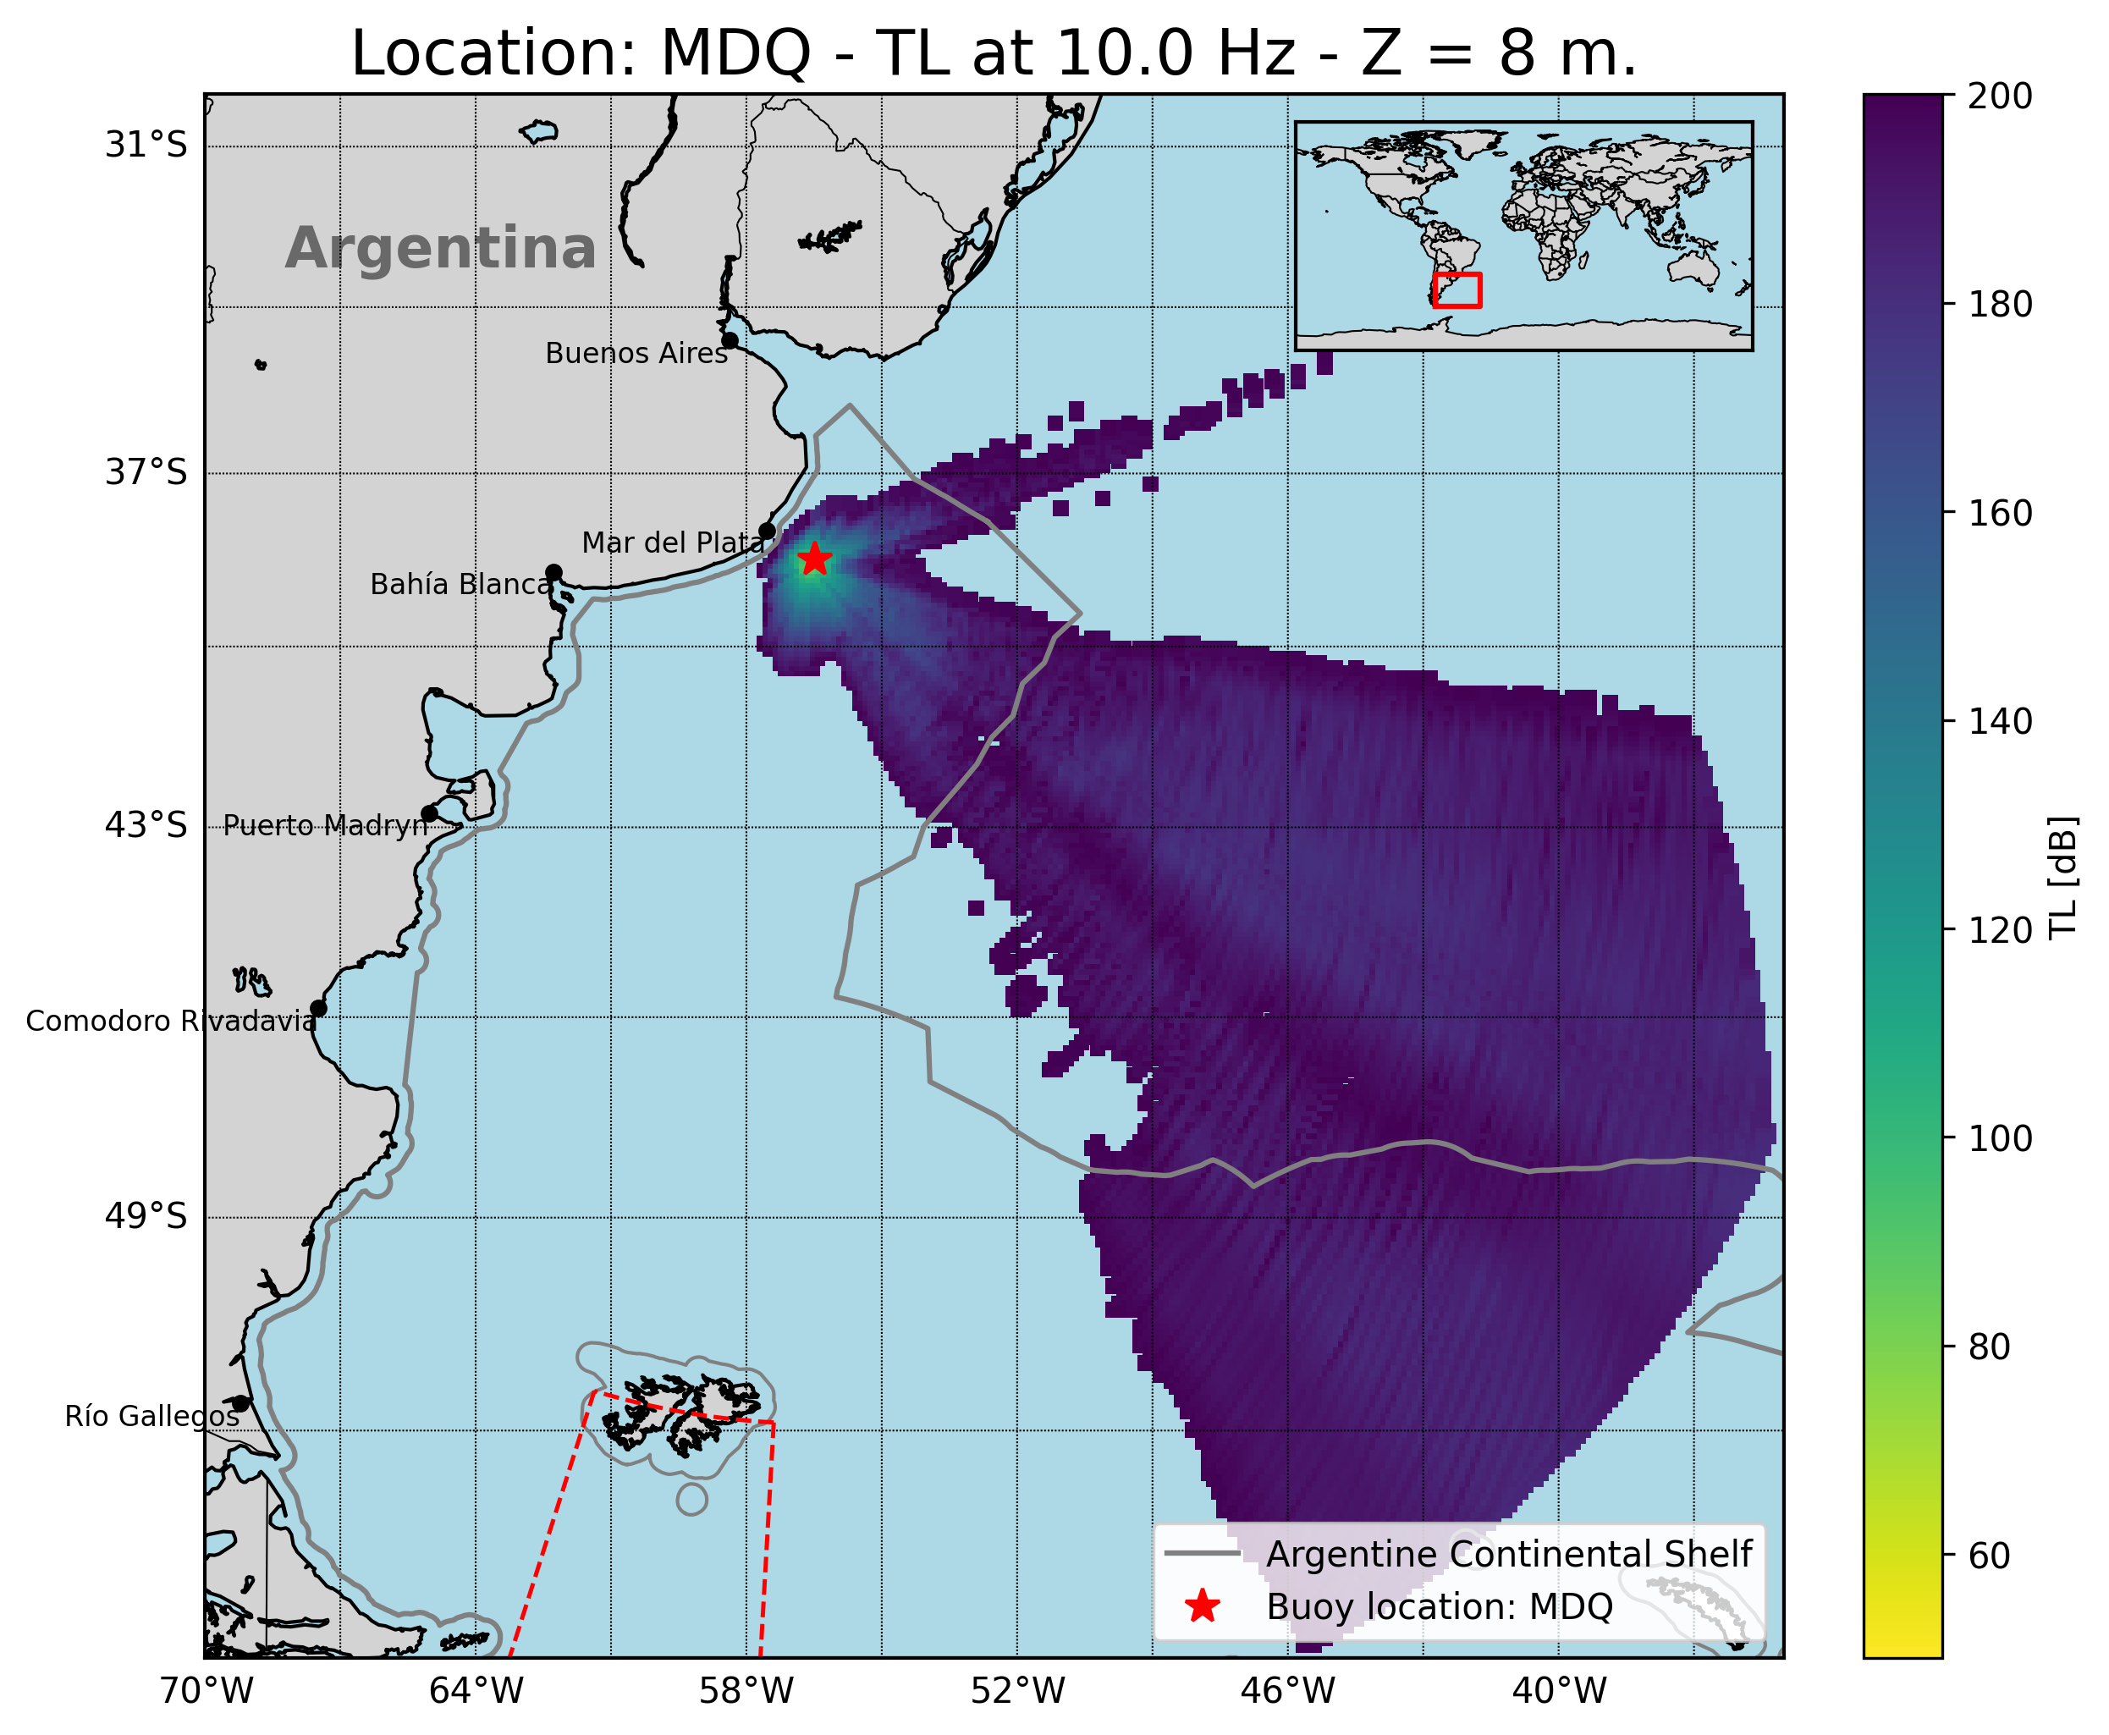
T1.3 - 299
A Portable Experimental Buoy for Coastal Acoustic Monitoring
Prario, I; Bos, P; Marques Rojo, R; Cinquini, M; Blanc, S.
Coverage of candidate 1 station (offshore Mar del Plata - MDQ)
Strong frequency dependence: lower frequencies (10 Hz) show larger shadow zones.
Shelf filtering effect: continental slope reduces transmission at low frequencies (<20 Hz).
Improved coverage at mid–high frequencies (50–80 Hz) across shelf and slope.
Shallow-water gap: limited detectability close to the coast (<200 m depth).
Implication: buoy at MDQ enhances monitoring in northern shelf region.

Slide 13
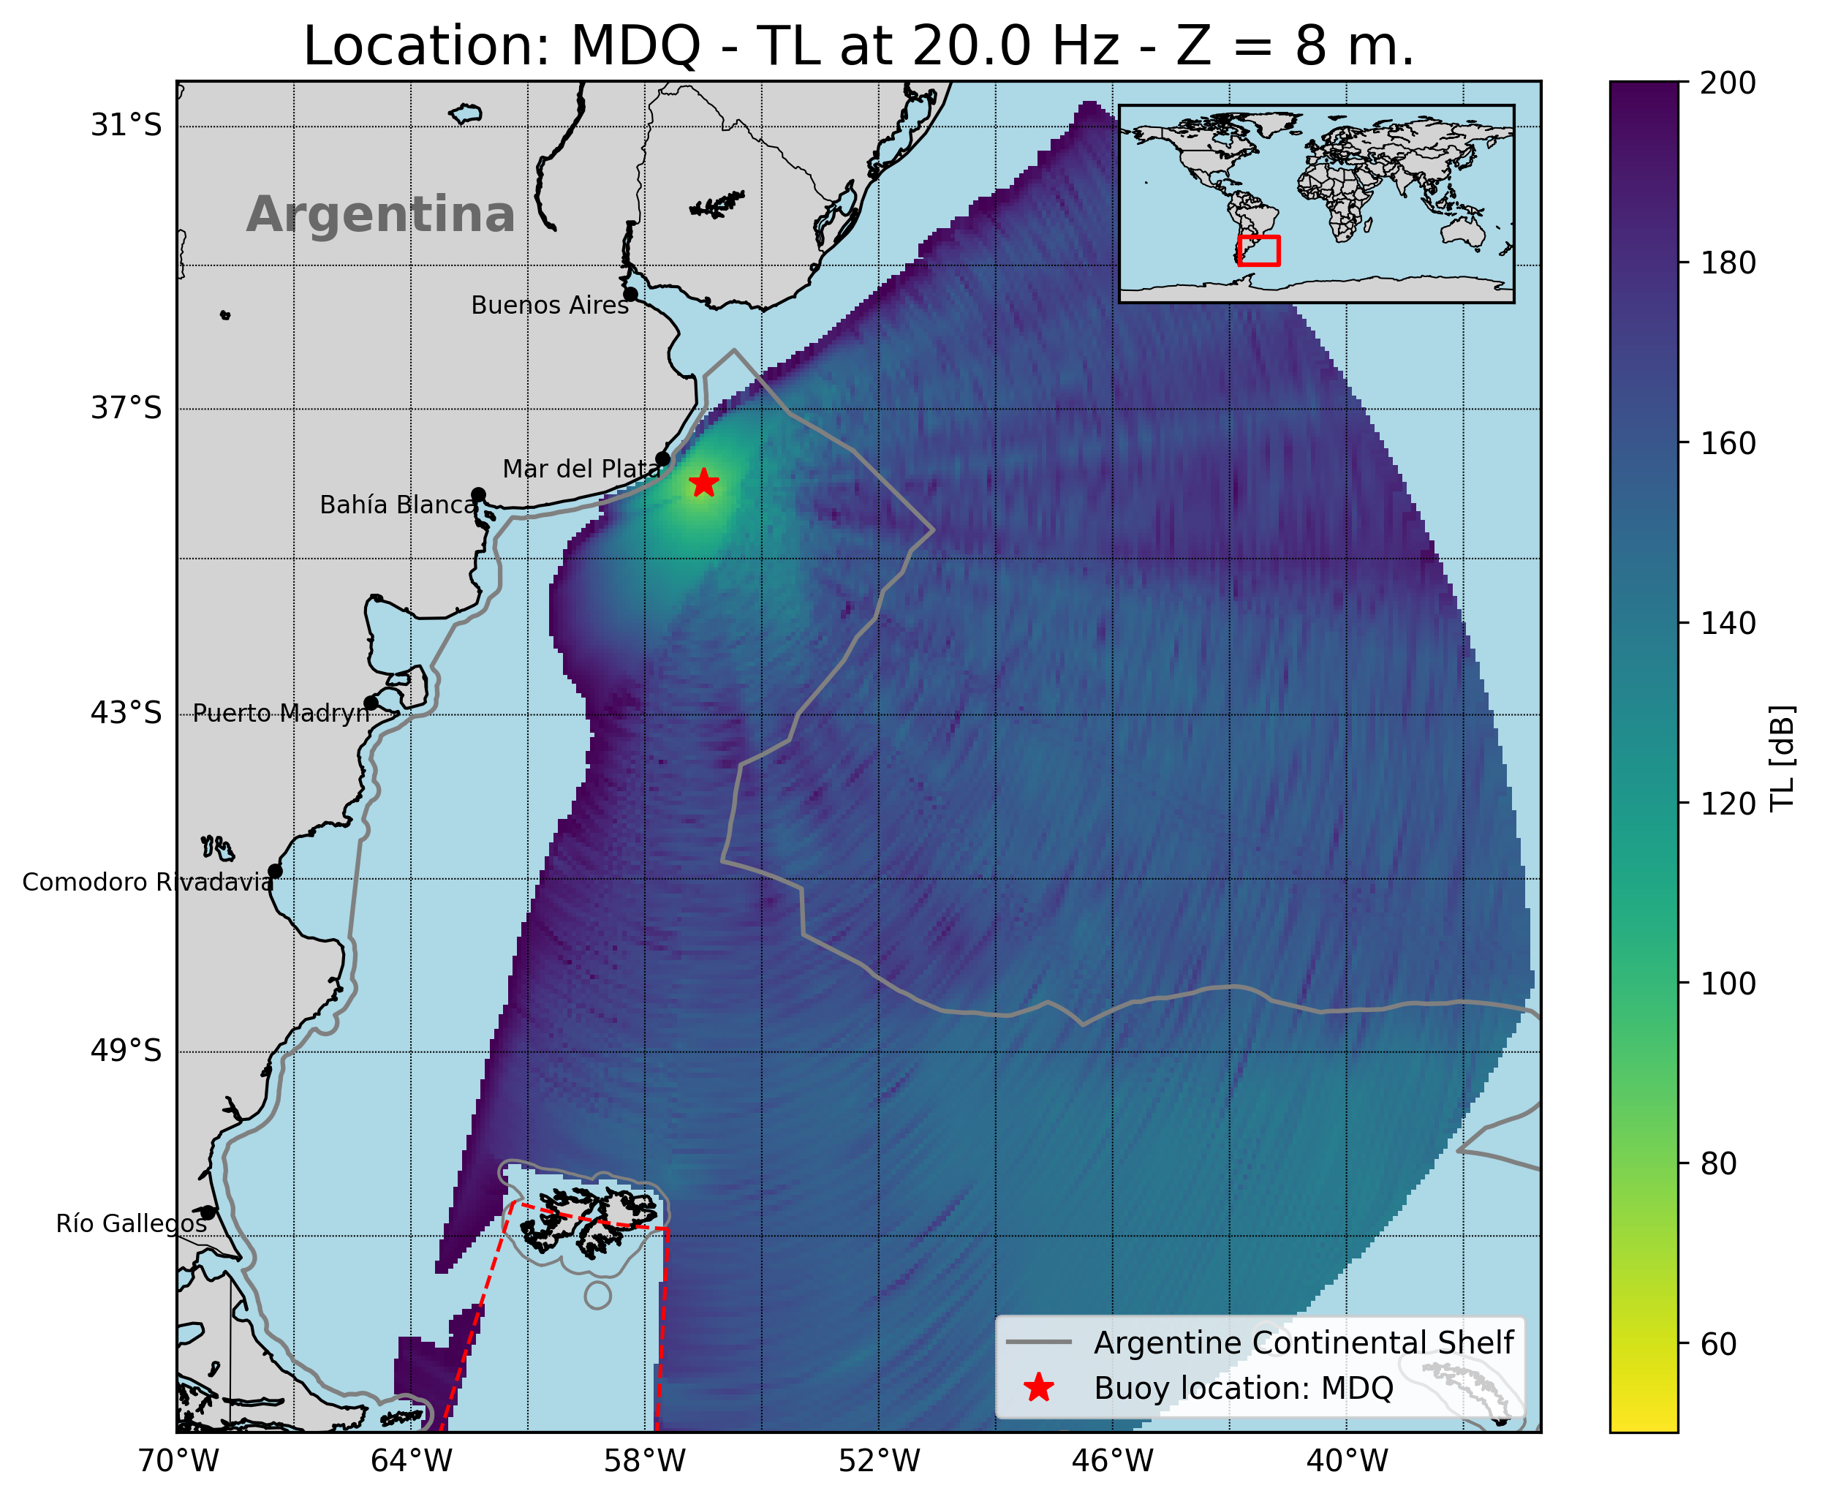
T1.3 - 299
A Portable Experimental Buoy for Coastal Acoustic Monitoring
Prario, I; Bos, P; Marques Rojo, R; Cinquini, M; Blanc, S.
Coverage of candidate 1 station (offshore Mar del Plata - MDQ)
Strong frequency dependence: lower frequencies (10 Hz) show larger shadow zones.
Shelf filtering effect: continental slope reduces transmission at low frequencies (<20 Hz).
Improved coverage at mid–high frequencies (50–80 Hz) across shelf and slope.
Shallow-water gap: limited detectability close to the coast (<200 m depth).
Implication: buoy at MDQ enhances monitoring in northern shelf region.

Slide 14
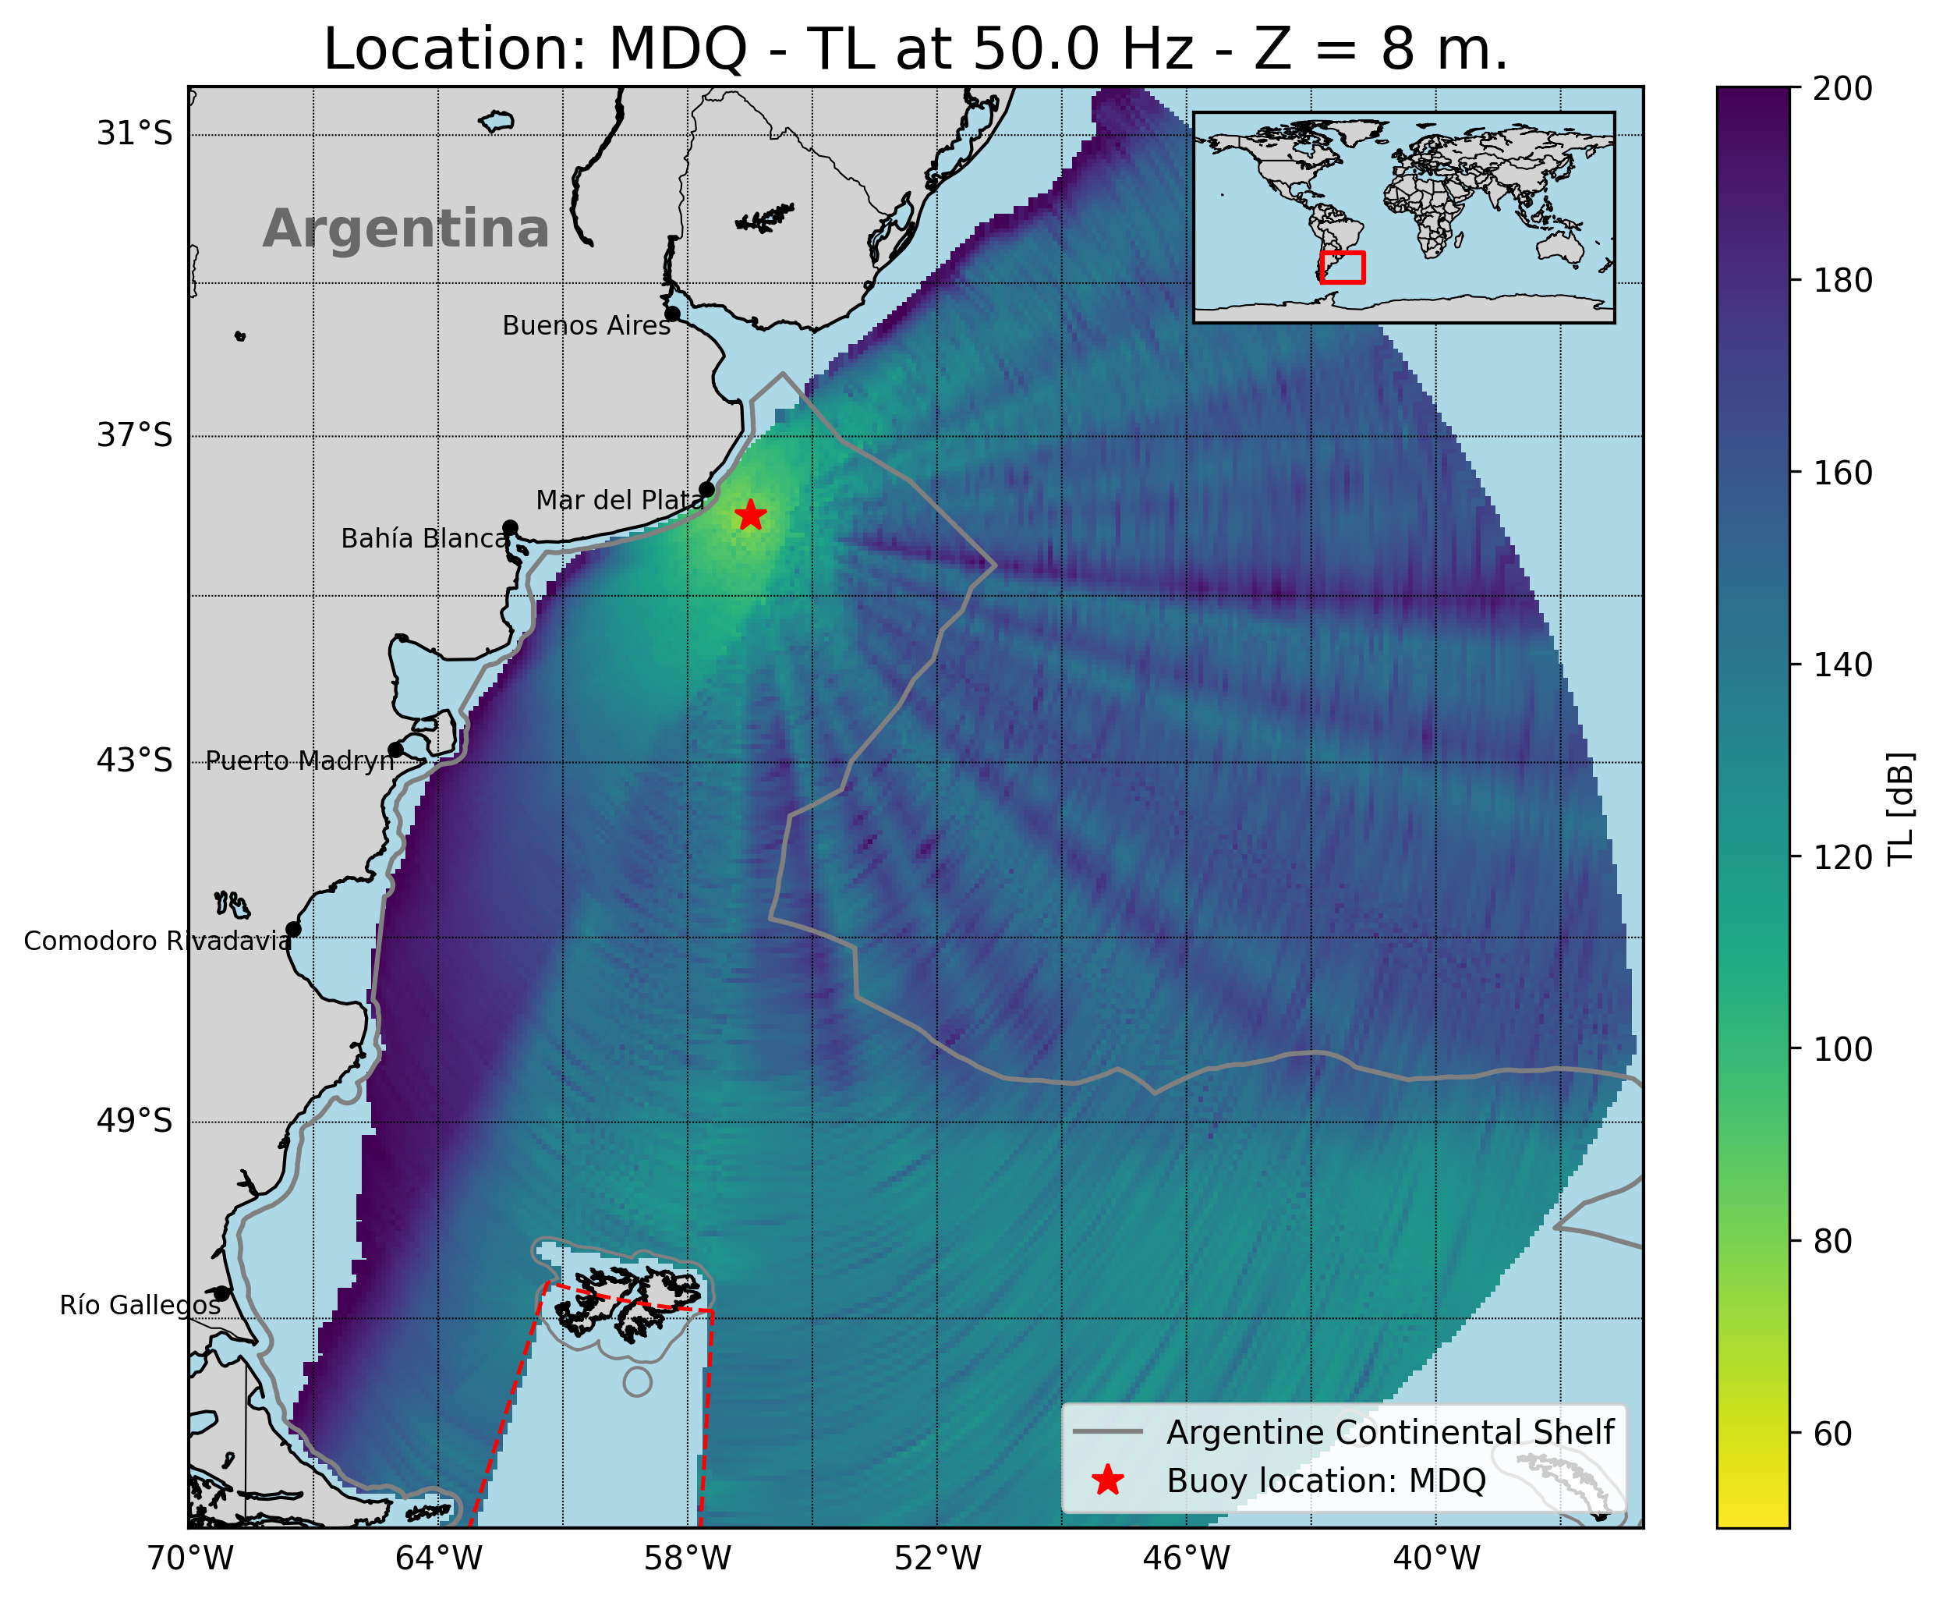
T1.3 - 299
A Portable Experimental Buoy for Coastal Acoustic Monitoring
Prario, I; Bos, P; Marques Rojo, R; Cinquini, M; Blanc, S.
Coverage of candidate 1 station (offshore Mar del Plata - MDQ)
Strong frequency dependence: lower frequencies (10 Hz) show larger shadow zones.
Shelf filtering effect: continental slope reduces transmission at low frequencies (<20 Hz).
Improved coverage at mid–high frequencies (50–80 Hz) across shelf and slope.
Shallow-water gap: limited detectability close to the coast (<200 m depth).
Implication: buoy at MDQ enhances monitoring in northern shelf region.

Slide 15
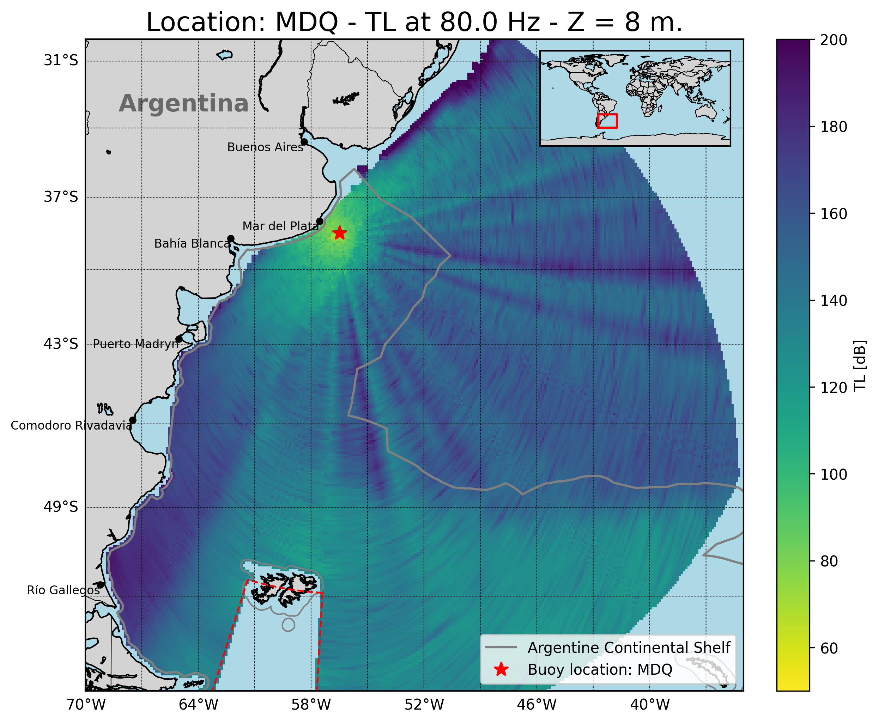
T1.3 - 299
A Portable Experimental Buoy for Coastal Acoustic Monitoring
Prario, I; Bos, P; Marques Rojo, R; Cinquini, M; Blanc, S.
Coverage of candidate 1 station (offshore Mar del Plata - MDQ)
Strong frequency dependence: lower frequencies (10 Hz) show larger shadow zones.
Shelf filtering effect: continental slope reduces transmission at low frequencies (<20 Hz).
Improved coverage at mid–high frequencies (50–80 Hz) across shelf and slope.
Shallow-water gap: limited detectability close to the coast (<200 m depth).
Implication: buoy at MDQ enhances monitoring in northern shelf region.

Slide 16
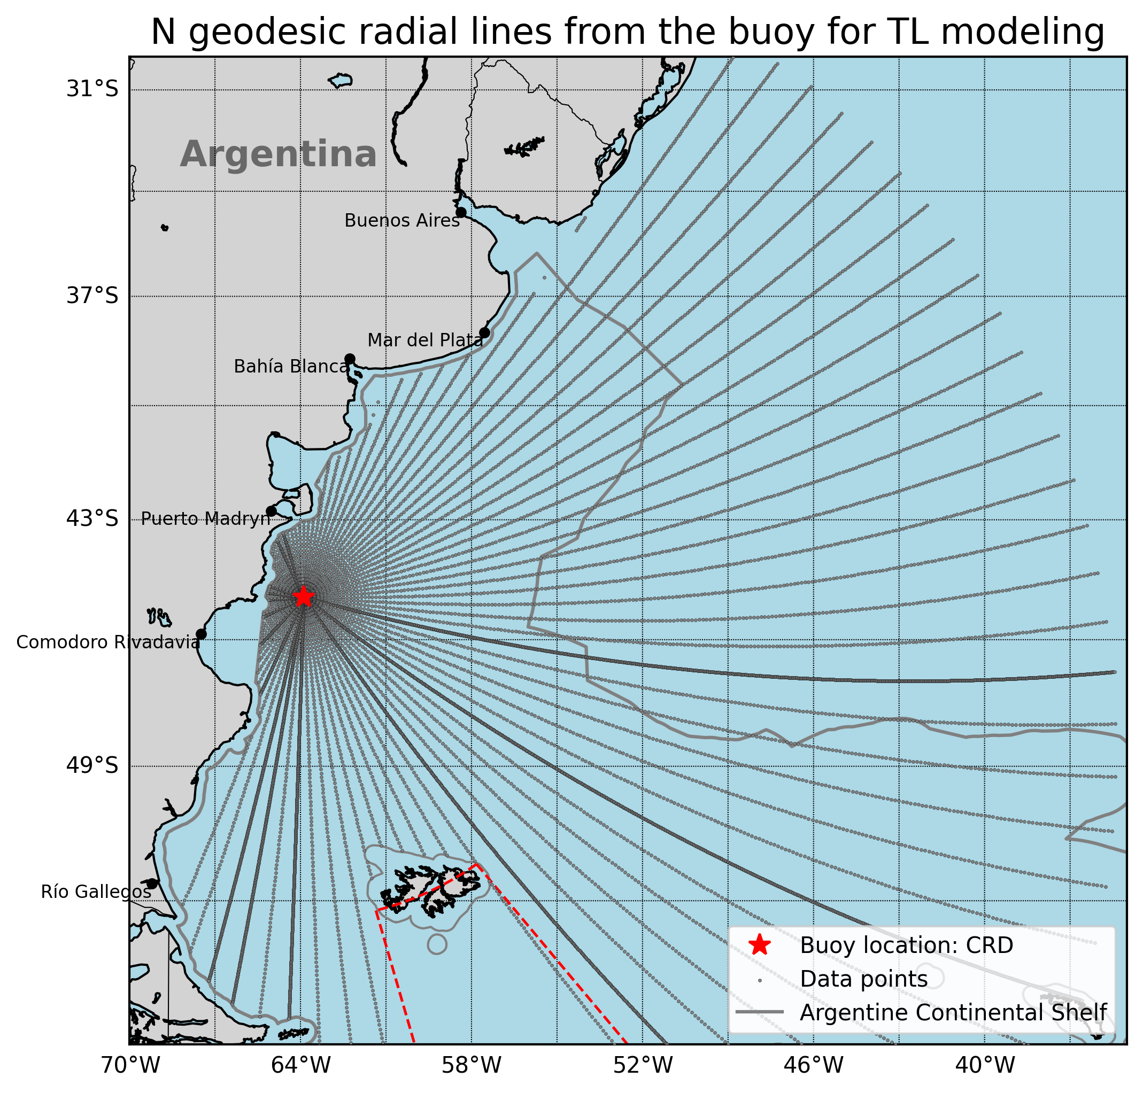
T1.3 - 299
A Portable Experimental Buoy for Coastal Acoustic Monitoring
Prario, I; Bos, P; Marques Rojo, R; Cinquini, M; Blanc, S.
Coverage of candidate 2 station (offshore Comodoro Rivadavia - CRD)
Model setup:
Frequency range: 2–100 Hz (results shown at 10, 20, 50, 80 Hz).
Source depth = 8 m (typical airgun tow depth).
Receiver depth (hydrophone) = 40 m.
Environmental inputs:
Oceanographic profiles from Copernicus.
Bathymetry from GEBCO database.
Simulation method:
2D RAM.
Transmission Loss (TL) along radial transects from the candidate buoy site in all directions.
Objective:
Assess acoustic coverage over the continental shelf and adjacent waters.

Slide 17
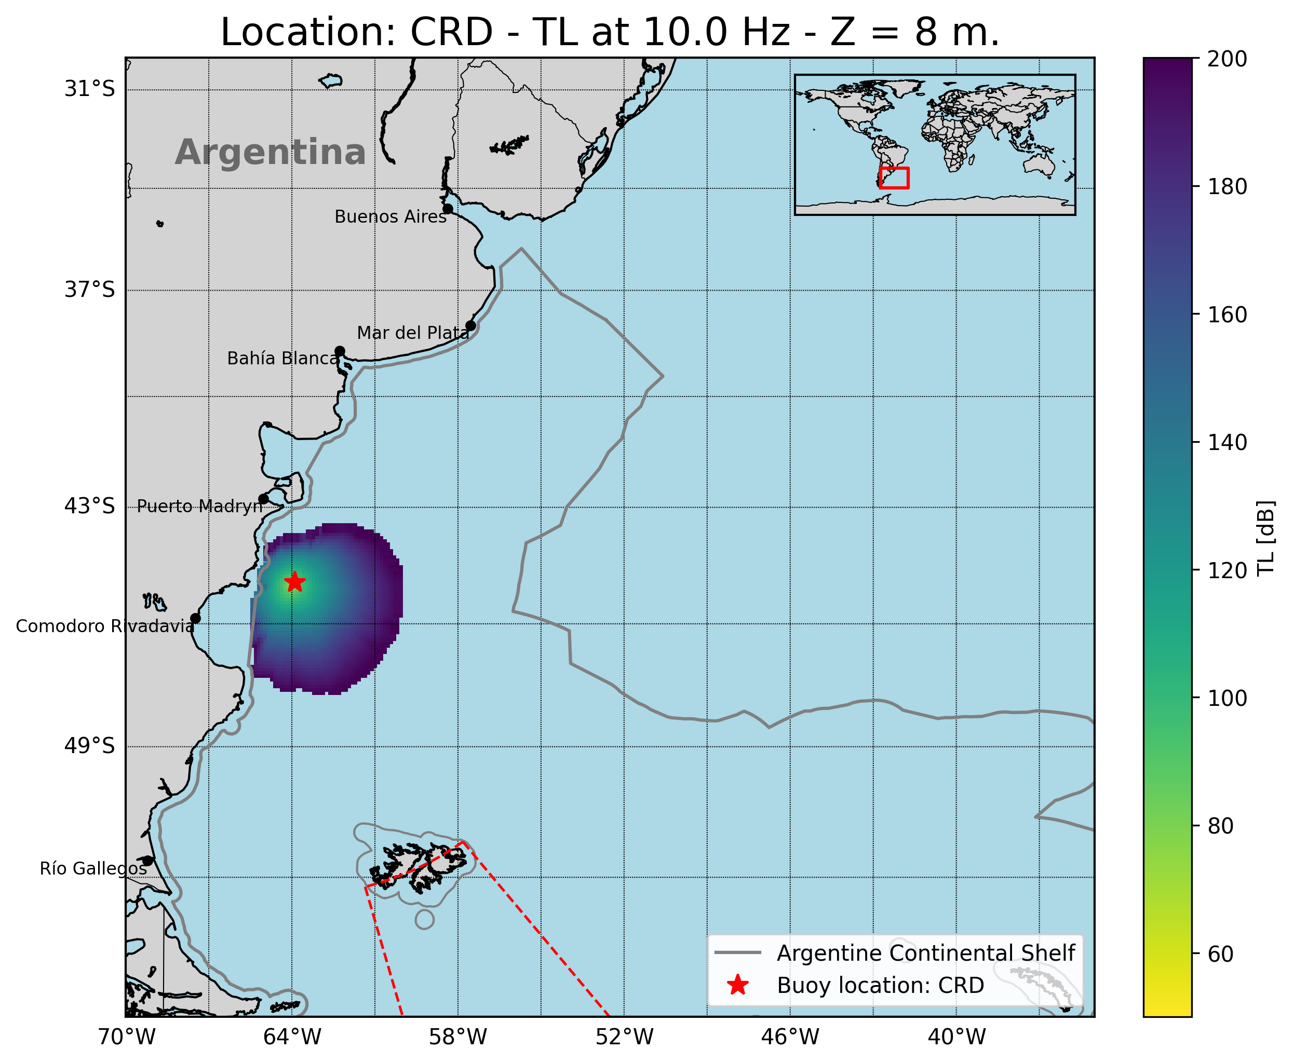
T1.3 - 299
A Portable Experimental Buoy for Coastal Acoustic Monitoring
Prario, I; Bos, P; Marques Rojo, R; Cinquini, M; Blanc, S.
Coverage of candidate 2 station (offshore Comodoro Rivadavia - CRD)
Marked frequency variation: stronger attenuation at 10–20 Hz, better propagation at 50–80 Hz.
Continental shelf slope creates coastal shadow zones at low frequencies.
Broader mid-frequency coverage compared to MDQ, extending farther offshore.
Shallow-water limitations remain near coastlines.
Implication: buoy at CRD improves coverage in southern shelf and complements MDQ site.

Slide 18
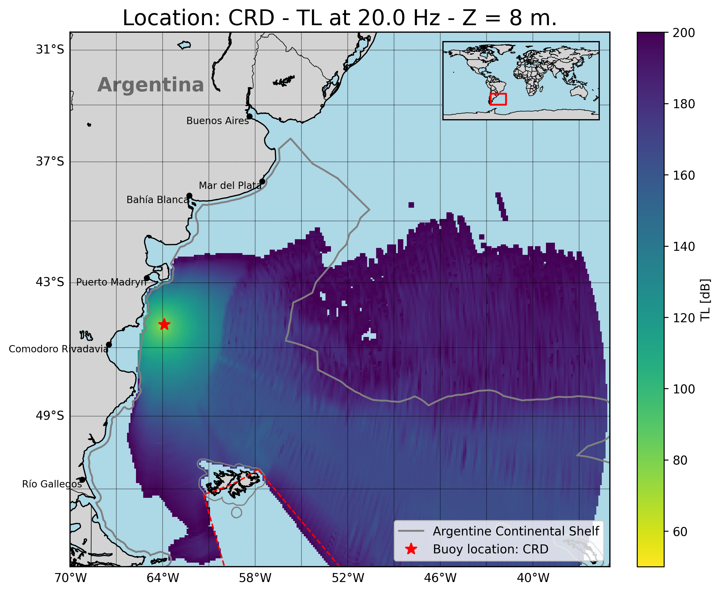
T1.3 - 299
A Portable Experimental Buoy for Coastal Acoustic Monitoring
Prario, I; Bos, P; Marques Rojo, R; Cinquini, M; Blanc, S.
Coverage of candidate 2 station (offshore Comodoro Rivadavia - CRD)
Marked frequency variation: stronger attenuation at 10–20 Hz, better propagation at 50–80 Hz.
Continental shelf slope creates coastal shadow zones at low frequencies.
Broader mid-frequency coverage compared to MDQ, extending farther offshore.
Shallow-water limitations remain near coastlines.
Implication: buoy at CRD improves coverage in southern shelf and complements MDQ site.

Slide 19
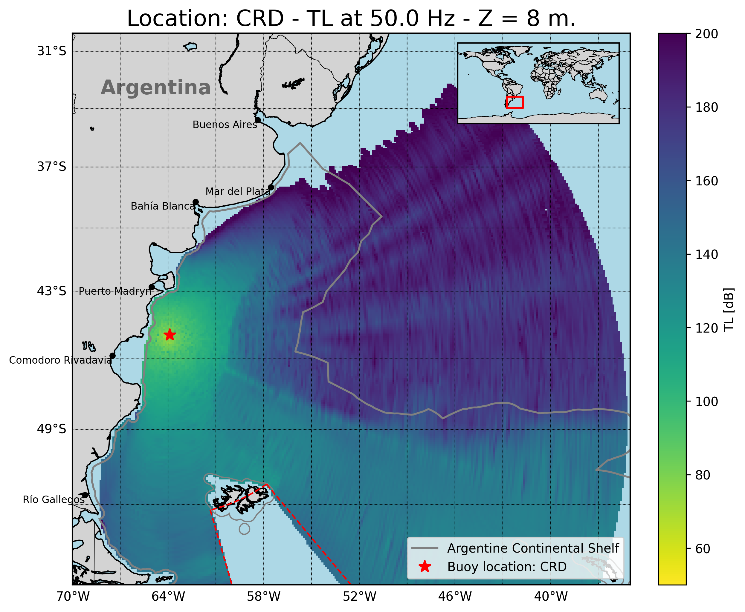
T1.3 - 299
A Portable Experimental Buoy for Coastal Acoustic Monitoring
Prario, I; Bos, P; Marques Rojo, R; Cinquini, M; Blanc, S.
Coverage of candidate 2 station (offshore Comodoro Rivadavia - CRD)
Marked frequency variation: stronger attenuation at 10–20 Hz, better propagation at 50–80 Hz.
Continental shelf slope creates coastal shadow zones at low frequencies.
Broader mid-frequency coverage compared to MDQ, extending farther offshore.
Shallow-water limitations remain near coastlines.
Implication: buoy at CRD improves coverage in southern shelf and complements MDQ site.

Slide 20
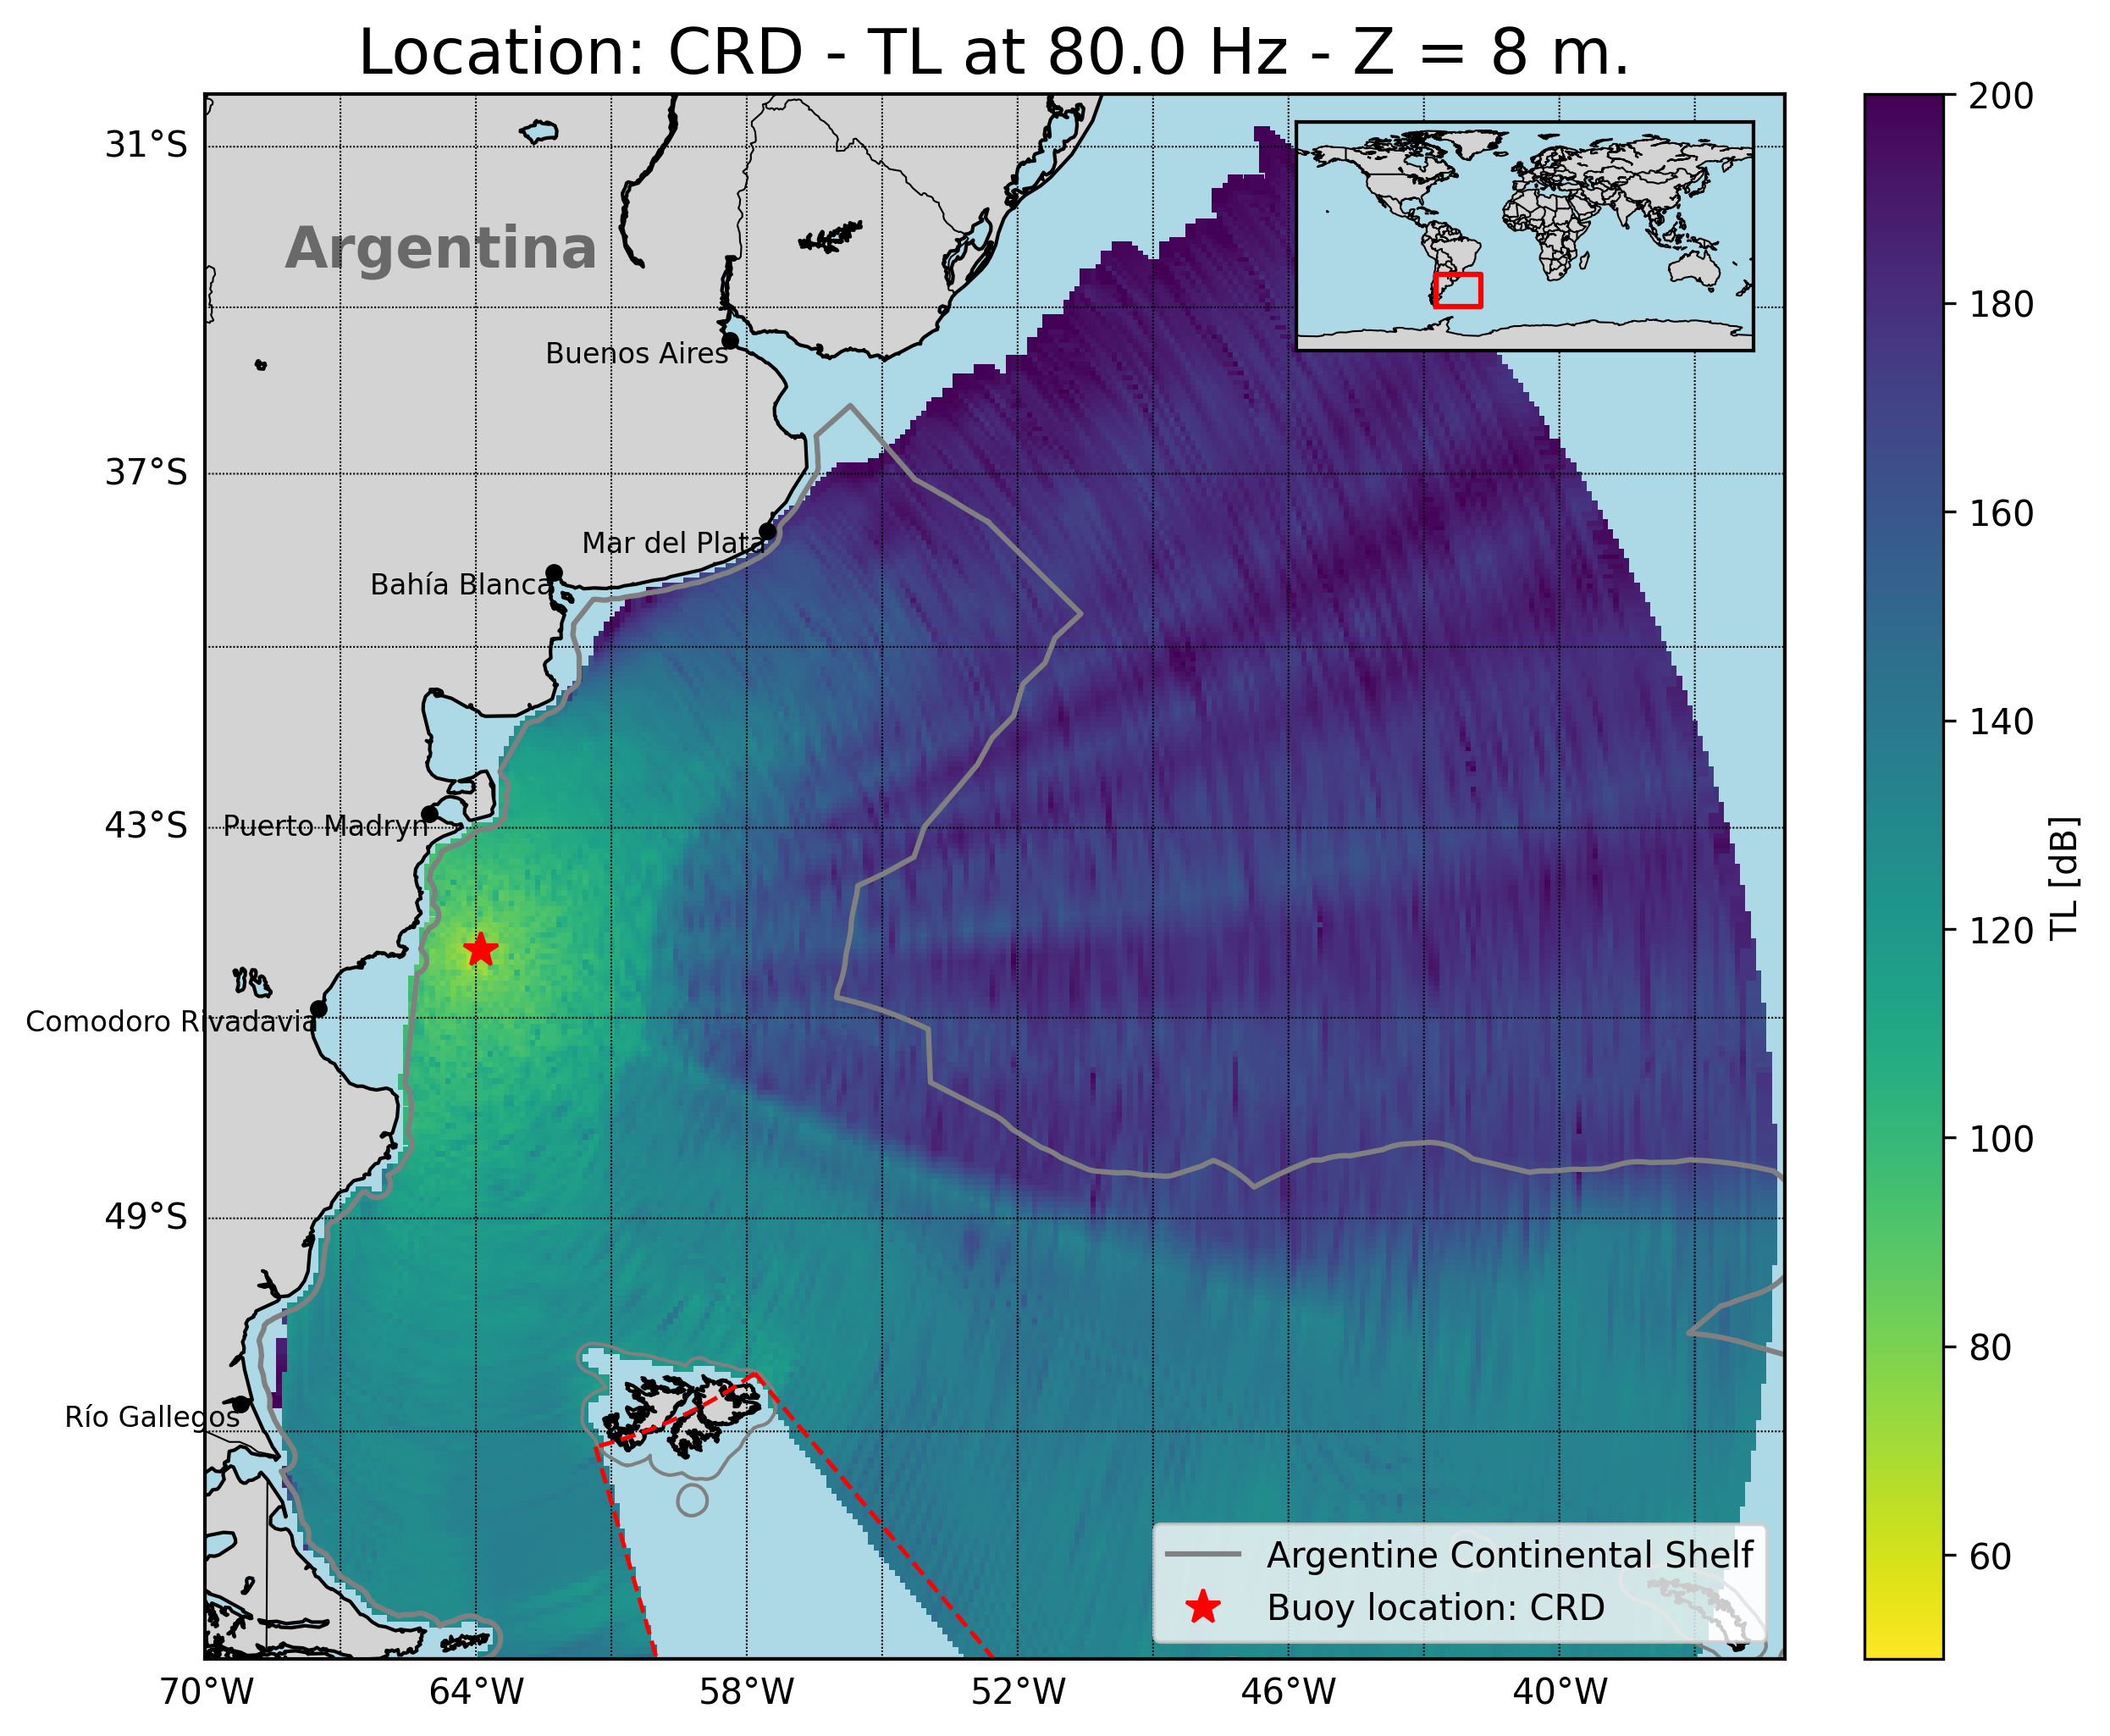
T1.3 - 299
A Portable Experimental Buoy for Coastal Acoustic Monitoring
Prario, I; Bos, P; Marques Rojo, R; Cinquini, M; Blanc, S.
Coverage of candidate 2 station (offshore Comodoro Rivadavia - CRD)
Marked frequency variation: stronger attenuation at 10–20 Hz, better propagation at 50–80 Hz.
Continental shelf slope creates coastal shadow zones at low frequencies.
Broader mid-frequency coverage compared to MDQ, extending farther offshore.
Shallow-water limitations remain near coastlines.
Implication: buoy at CRD improves coverage in southern shelf and complements MDQ site.

Slide 21
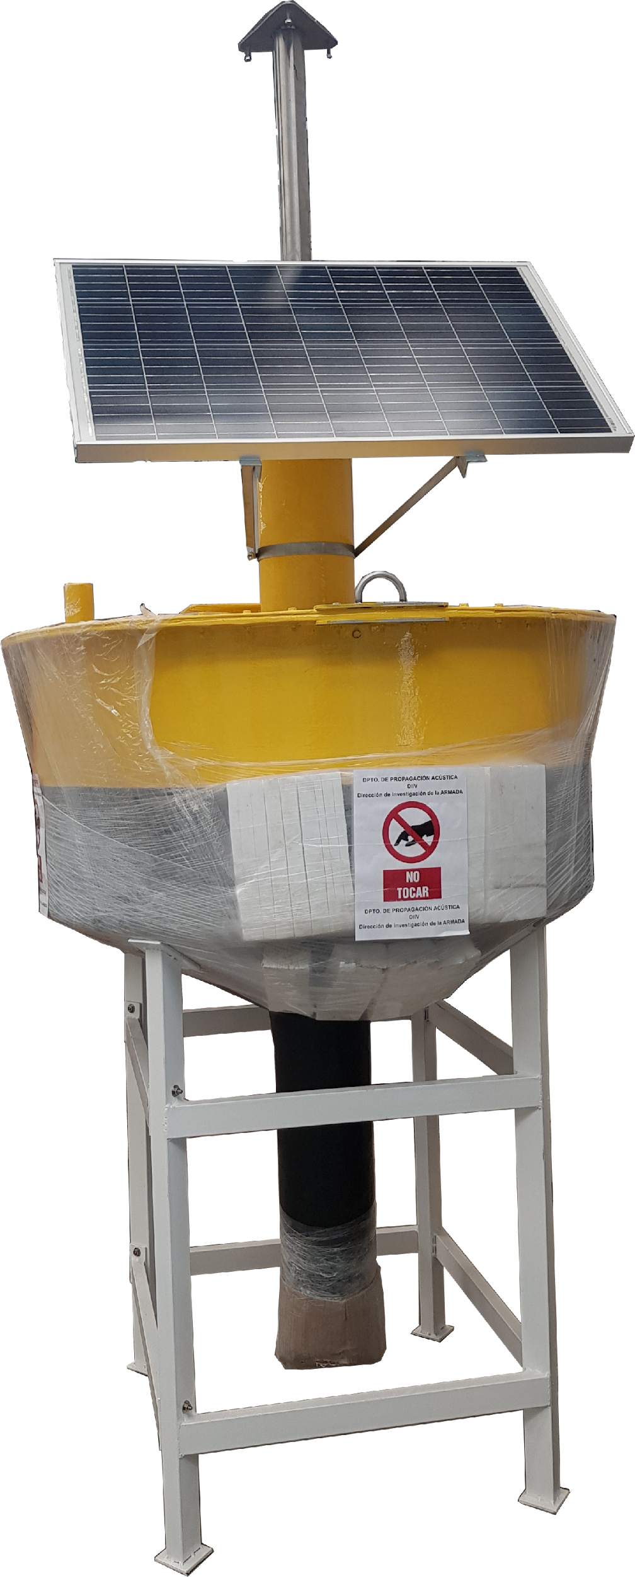
T1.3 - 299
A Portable Experimental Buoy for Coastal Acoustic Monitoring
Prario, I; Bos, P; Marques Rojo, R; Cinquini, M; Blanc, S.
Experimental Buoy Platform for hydrophones deployment
This custom-designed buoy is a prototype platform developed for the deployment of hydroacoustic instrumentation in a coastal environment.
It features:
A GRP (Glass-Reinforced Plastic) hull for corrosion resistance and lightweight performance.
A solar power system to support autonomous operations.
A sealed electronics compartment and a central mast for sensors, antennas, satellite transmission and GPS.
Designed to withstand harsh marine conditions, including strong currents and waves up to 4 meters.

Slide 22
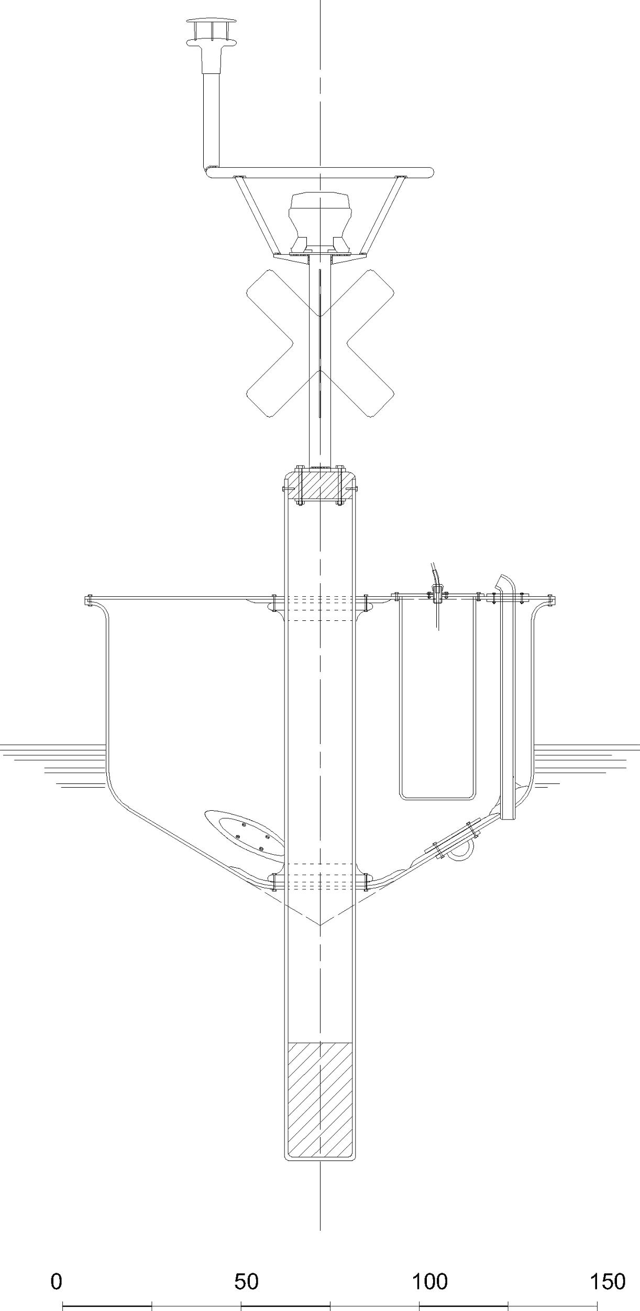
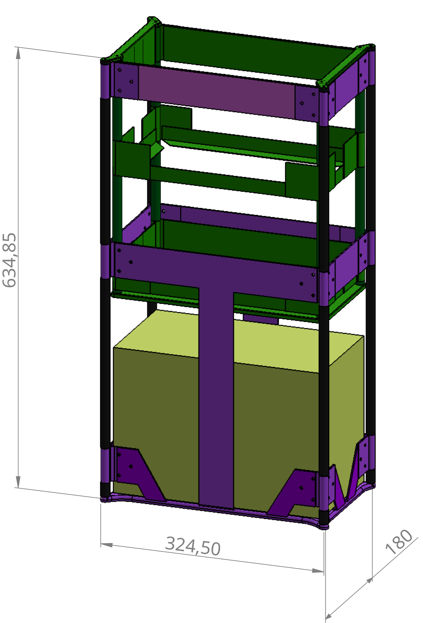
T1.3 - 299
A Portable Experimental Buoy for Coastal Acoustic Monitoring
Prario, I; Bos, P; Marques Rojo, R; Cinquini, M; Blanc, S.
Buoy Electronics Rack
Removable, lift-out aluminum rack houses:
Fanless embedded computer
24-bit audio interface for hydrophone digitization
Low-noise hydrophone preamplifiers
AIS (Automatic Identification System)
Satellite modem for telemetry and command
Deep-cycle battery with solar charge controller

Slide 23
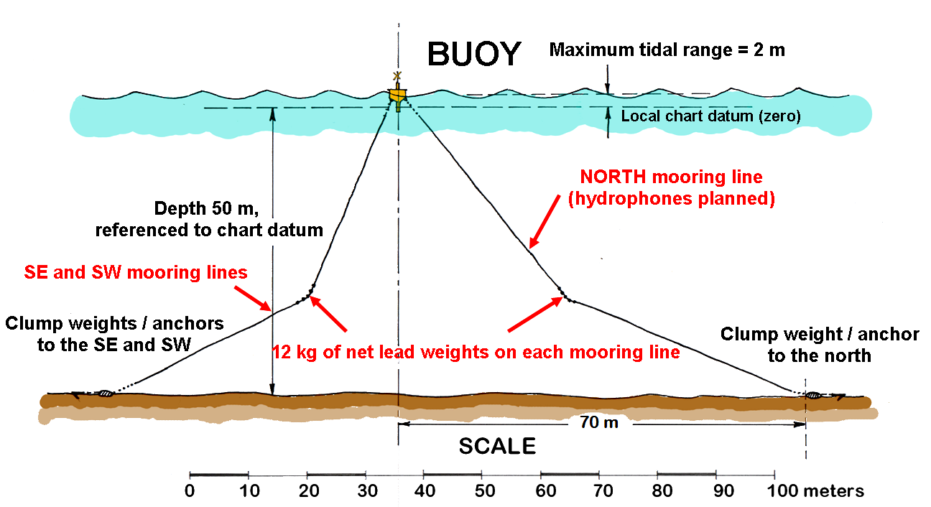
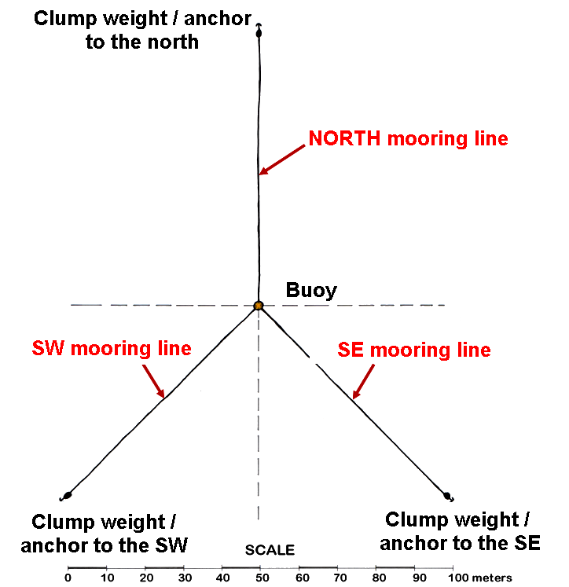
T1.3 - 299
A Portable Experimental Buoy for Coastal Acoustic Monitoring
Prario, I; Bos, P; Marques Rojo, R; Cinquini, M; Blanc, S.
SCHEMATIC OF THE BUOY MOORING SYSTEM WITH HYDROPHONES

Slide 24
T1.3 - 299
A Portable Experimental Buoy for Coastal Acoustic Monitoring
Prario, I; Bos, P; Marques Rojo, R; Cinquini, M; Blanc, S.
Layered Architecture of the Embedded System
🔝 Orchestrator Layer
Coordinates overall system flow.
Decides which FSM to activate and when.
Handles high-level internal and external events.
🔁 State Machine Layer (FSM)
Manages module behaviour based on current state.
Responds to events, executes actions, changes states.
⚙️ Low-Level Driver Layer
Interfaces directly with hardware.
Performs device I/O and peripheral configuration.
Task Manager (System Orchestrator)
Event reporting through message queues
Signals to FSM
Finite State Machine (FSM)
Calls to driver methods
Return status (OK / ERROR)
Low-Level Driver

Slide 25
T1.3 - 299
A Portable Experimental Buoy for Coastal Acoustic Monitoring
Prario, I; Bos, P; Marques Rojo, R; Cinquini, M; Blanc, S.
Layered Architecture of the Embedded System
🔝 Orchestrator Layer
Coordinates overall system flow.
Decides which FSM to activate and when.
Handles high-level internal and external events.
🔁 State Machine Layer (FSM)
Manages module behaviour based on current state.
Responds to events, executes actions, changes states.
⚙️ Low-Level Driver Layer
Interfaces directly with hardware.
Performs device I/O and peripheral configuration.
Task Manager (System Orchestrator)
Event reporting through message queues
Signals to FSM
Finite State Machine (FSM)
Calls to driver methods
Return status (OK / ERROR)
Low-Level Driver

Slide 26
T1.3 - 299
A Portable Experimental Buoy for Coastal Acoustic Monitoring
Prario, I; Bos, P; Marques Rojo, R; Cinquini, M; Blanc, S.
Layered Architecture of the Embedded System
🔝 Orchestrator Layer
Coordinates overall system flow.
Decides which FSM to activate and when.
Handles high-level internal and external events.
🔁 State Machine Layer (FSM)
Manages module behaviour based on current state.
Responds to events, executes actions, changes states.
⚙️ Low-Level Driver Layer
Interfaces directly with hardware.
Performs device I/O and peripheral configuration.
Task Manager (System Orchestrator)
Event reporting through message queues
Signals to FSM
Finite State Machine (FSM)
Calls to driver methods
Return status (OK / ERROR)
Low-Level Driver

Slide 27
T1.3 - 299
A Portable Experimental Buoy for Coastal Acoustic Monitoring
Prario, I; Bos, P; Marques Rojo, R; Cinquini, M; Blanc, S.
Layered Architecture of the Embedded System
🔝 Orchestrator Layer
Coordinates overall system flow.
Decides which FSM to activate and when.
Handles high-level internal and external events.
🔁 State Machine Layer (FSM)
Manages module behaviour based on current state.
Responds to events, executes actions, changes states.
⚙️ Low-Level Driver Layer
Interfaces directly with hardware.
Performs device I/O and peripheral configuration.
Task Manager (System Orchestrator)
Event reporting through message queues
Signals to FSM
Finite State Machine (FSM)
Calls to driver methods
Return status (OK / ERROR)
Low-Level Driver

Slide 28
T1.3 - 299
A Portable Experimental Buoy for Coastal Acoustic Monitoring
Prario, I; Bos, P; Marques Rojo, R; Cinquini, M; Blanc, S.
State Machine Design Pattern
This generic FSM pattern is used across multiple modules to manage their internal logic and execution flow.
DISABLE: The module is inactive and resources are released.
INIT: Initializes hardware and internal variables.
TEST: Performs self-checks and verifies correct functionality.
ERROR: Captures faults and attempts recovery or shutdown.
IDLE: Waits for commands or events.
RUN JOB: Executes the main task or acquisition.
Transitions are triggered by internal events or commands.
Each FSM has a scheduler, message_handler and update functions
DISABLE
INIT
TEST
ERROR
IDLE
RUN JOB

Slide 29
T1.3 - 299
A Portable Experimental Buoy for Coastal Acoustic Monitoring
Prario, I; Bos, P; Marques Rojo, R; Cinquini, M; Blanc, S.
State Machine Design Pattern
This generic FSM pattern is used across multiple modules to manage their internal logic and execution flow.
DISABLE: The module is inactive and resources are released.
INIT: Initializes hardware and internal variables.
TEST: Performs self-checks and verifies correct functionality.
ERROR: Captures faults and attempts recovery or shutdown.
IDLE: Waits for commands or events.
RUN JOB: Executes the main task or acquisition.
Transitions are triggered by internal events or commands.
Each FSM has a scheduler, message_handler and update functions
DISABLE
INIT
TEST
ERROR
IDLE
RUN JOB

Slide 30
T1.3 - 299
A Portable Experimental Buoy for Coastal Acoustic Monitoring
Prario, I; Bos, P; Marques Rojo, R; Cinquini, M; Blanc, S.
State Machine Design Pattern
This generic FSM pattern is used across multiple modules to manage their internal logic and execution flow.
DISABLE: The module is inactive and resources are released.
INIT: Initializes hardware and internal variables.
TEST: Performs self-checks and verifies correct functionality.
ERROR: Captures faults and attempts recovery or shutdown.
IDLE: Waits for commands or events.
RUN JOB: Executes the main task or acquisition.
Transitions are triggered by internal events or commands.
Each FSM has a scheduler, message_handler and update functions
DISABLE
INIT
TEST
ERROR
IDLE
RUN JOB

Slide 31
T1.3 - 299
A Portable Experimental Buoy for Coastal Acoustic Monitoring
Prario, I; Bos, P; Marques Rojo, R; Cinquini, M; Blanc, S.
State Machine Design Pattern
This generic FSM pattern is used across multiple modules to manage their internal logic and execution flow.
DISABLE: The module is inactive and resources are released.
INIT: Initializes hardware and internal variables.
TEST: Performs self-checks and verifies correct functionality.
ERROR: Captures faults and attempts recovery or shutdown.
IDLE: Waits for commands or events.
RUN JOB: Executes the main task or acquisition.
Transitions are triggered by internal events or commands.
Each FSM has a scheduler, message_handler and update functions
DISABLE
INIT
TEST
ERROR
IDLE
RUN JOB

Slide 32
T1.3 - 299
A Portable Experimental Buoy for Coastal Acoustic Monitoring
Prario, I; Bos, P; Marques Rojo, R; Cinquini, M; Blanc, S.
State Machine Design Pattern
This generic FSM pattern is used across multiple modules to manage their internal logic and execution flow.
DISABLE: The module is inactive and resources are released.
INIT: Initializes hardware and internal variables.
TEST: Performs self-checks and verifies correct functionality.
ERROR: Captures faults and attempts recovery or shutdown.
IDLE: Waits for commands or events.
RUN JOB: Executes the main task or acquisition.
Transitions are triggered by internal events or commands.
Each FSM has a scheduler, message_handler and update functions
DISABLE
INIT
TEST
ERROR
IDLE
RUN JOB

Slide 33
T1.3 - 299
A Portable Experimental Buoy for Coastal Acoustic Monitoring
Prario, I; Bos, P; Marques Rojo, R; Cinquini, M; Blanc, S.
State Machine Design Pattern
This generic FSM pattern is used across multiple modules to manage their internal logic and execution flow.
DISABLE: The module is inactive and resources are released.
INIT: Initializes hardware and internal variables.
TEST: Performs self-checks and verifies correct functionality.
ERROR: Captures faults and attempts recovery or shutdown.
IDLE: Waits for commands or events.
RUN JOB: Executes the main task or acquisition.
Transitions are triggered by internal events or commands.
Each FSM has a scheduler, message_handler and update functions
DISABLE
INIT
TEST
ERROR
IDLE
RUN JOB

Slide 34
T1.3 - 299
A Portable Experimental Buoy for Coastal Acoustic Monitoring
Prario, I; Bos, P; Marques Rojo, R; Cinquini, M; Blanc, S.
State Machine Design Pattern
This generic FSM pattern is used across multiple modules to manage their internal logic and execution flow.
DISABLE: The module is inactive and resources are released.
INIT: Initializes hardware and internal variables.
TEST: Performs self-checks and verifies correct functionality.
ERROR: Captures faults and attempts recovery or shutdown.
IDLE: Waits for commands or events.
RUN JOB: Executes the main task or acquisition.
Transitions are triggered by internal events or commands.
Each FSM has a scheduler, message_handler and update functions
DISABLE
INIT
TEST
ERROR
IDLE
RUN JOB

Slide 35
T1.3 - 299
A Portable Experimental Buoy for Coastal Acoustic Monitoring
Prario, I; Bos, P; Marques Rojo, R; Cinquini, M; Blanc, S.
Conclusions
A low-cost prototype buoy for coastal acoustic monitoring is under integration, designed for robustness and autonomous operation.
The system complements IMS hydroacoustic stations by addressing shallow-water coverage gaps on the Argentine continental shelf.
Proposed deployment sites (MDQ and CRD) optimise detection in previously uncovered regions.
This platform paves the way for a scalable coastal monitoring system supporting baseline studies of ambient underwater noise and long-range propagation analysis.

